Slide 1
DP-600: Microsoft Fabric Analytics Engineer
Day 3
Notes:
Instructor notes and guidance.
This space has been left deliberately blank

Slide 2
Add measures to Power BI semantic models
Notes:
https://aka.ms/power-bi-measures
Before delivering this presentation, review the associated module on Microsoft Learn.
The estimated time to present these slides is 45 minutes.

Slide 3
Learning objectives
Understand implicit and explicit measures.
Create measures, calculated columns, and calculated tables.
Identify when to use a measure or calculated column.
Notes:
Perhaps you've heard that Power BI can seamlessly handle trillions of rows of data, but you're not able to accomplish that in your own Power BI tenant. Working with high volume and large-scale data can be done in Fabric and Power BI with the right groundwork in place.
This module introduces considerations for building enterprise scale, IT-driven solutions. You'll review data modeling best practices and Power BI Premium/Fabric features for working with large data.

Slide 4
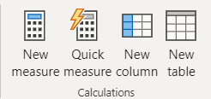
What is DAX?
Data Analysis Expressions
Library of functions and operators
Build formulas and expressions
Create calculated measures, columns, and tables
Notes:
Data Analysis Expressions (DAX) is a programming language that is used throughout Microsoft Power BI for creating calculated columns, measures, and custom tables. It is a collection of functions, operators, and constants that can be used in a formula, or expression, to calculate and return one or more values. You can use DAX to solve numerous calculations and data analysis problems, which can help you create new information from data that is already in your model.
In Power BI, you can use different calculation techniques and functions to create measures or calculated columns. Primarily, you will be able to achieve the same result by using these techniques; however, the key is to know how and when to apply them. By having a basic understanding of when and how to use which technique, you will be able to create robust and high-performance data models.

Slide 5
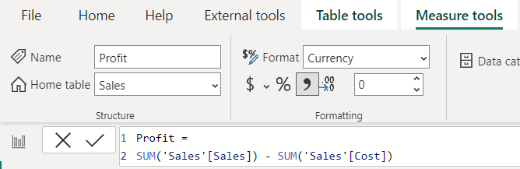
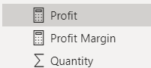
Create measures
Defined with DAX formulas.
Computed on the fly.
Not stored in data model.
Responsive to interactions.
Indicated by calculator icon.
Notes:
Measures in Power BI are essential for performing calculations and summarizing data within a DAX model. They enable the aggregation of values across multiple rows, allowing for a comprehensive view of the data.
By default, Power BI automatically aggregates numerical columns using functions like sum, average, min, max, count, or count distinct as the default summarization. This automatic aggregation is called an implicit measure, indicated by the sigma symbol. You can modify or disable implicit measures by adjusting the default summarization settings.
Explicit measures, on the other hand, are intentionally created measures where you define the calculation in the formula bar. With explicit measures, you have full control over the calculation logic and cannot modify the summarization once defined. They are indicated by a calculator icon.
Measures are commonly used in data analysis and offer a wide range of functions, including sums, averages, minimums, maximums, and counts. What makes measures particularly powerful is that they are not pre-calculated; their values are determined only when used in a report. This dynamic nature ensures that measures update in real-time, responding to user interactions within the report.
This dynamic behavior is one of the key advantages of Power BI reports. By creating measure calculations and combining them with filters and other visuals, users can explore the data and generate insightful visualizations. This flexibility empowers users to uncover meaningful insights and delve deeper into the data based on their specific needs and interests.
Use a simple measure to calculate a SUM or DIVIDE two columns. Create a compound measure by referencing one or more measures within another, such as the Profit measure in the screenshot.

Slide 6
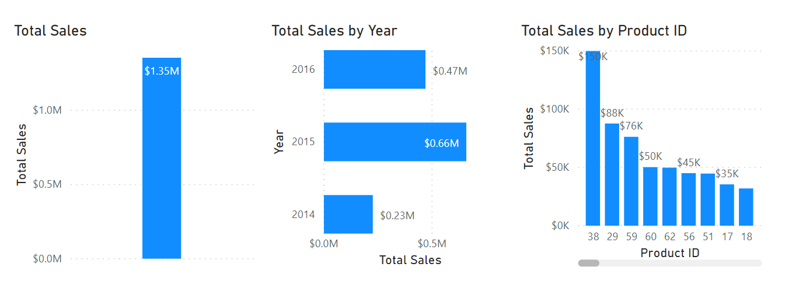
Understanding filter context
Measures are contextually different, or “dynamic,” depending on filters.
Notes:
Filter context in DAX refers to the set of filters applied to data, influencing how calculations and measures are computed and displayed.
For example, these three visuals use the exact same DAX measure: Total Sales. Each visual uses the same DAX measure.
The first visual shows the Total Sales measure without filters.
The second visual is filtered by year.
The third visual, Total Sales is filtered by Product ID.
With Power BI, even though the measure was only defined once, it can be used in these visuals in different ways. Each of the totals is accurate and performs quickly. It is the context of how the DAX measure is used that calculates these totals accurately.

Slide 7
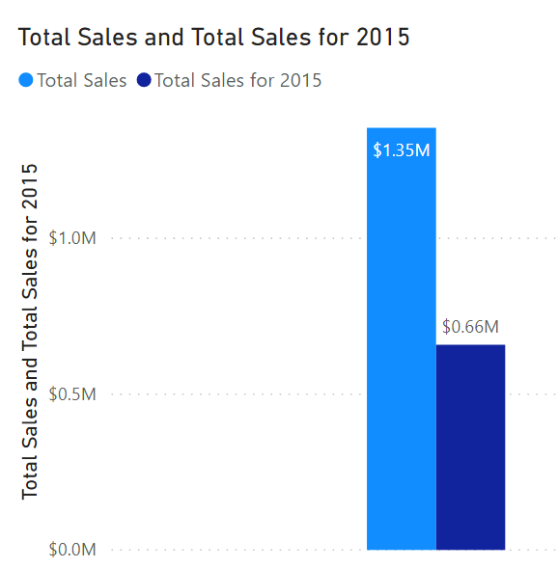
CALCULATE() function
Adjusts how measures interpret data filters, enabling context control.
Total Sales for 2015 =
CALCULATE (
SUM ( 'Sales OrderDetails'[Total Price] ),
YEAR ( 'Sales OrderDetails’[OrderDate] ) = 2015
)
Notes:
The CALCULATE function in DAX is one of the most important functions that a data analyst can learn. The function name does not adequately describe what it is intended to do.
The CALCULATE function is your method of creating a DAX measure that will override certain portions of the context that are being used to express the correct result.
For instance, if you want to create a measure that always calculates the total sales for 2015, regardless of which year is selected in any other visual in Power BI, you would create a measure that is similar to the syntax in the following sample:
Total Sales for 2015 = CALCULATE(SUM('Sales OrderDetails'[Total Price]), YEAR('Sales OrderDetails’[OrderDate]) = 2015)
Notice how the measure is named Total Sales for 2015. When you use the CALCULATE function to override the context, it is helpful to name the measure in a way that describes exactly how you are overriding it. In this example, CALCULATE is aggregating the Total Price column, just as you did in the previous measure. However, instead of operating over the entire semantic model while using whatever the filter context tells it to do, you are overriding the filter context for the year 2015. No matter what year is selected, you will always get the total for 2015; all other filters still apply. The subsequent example shows this concept in action.
When both measures are added to the previous visual they will resemble the following screenshot.
As shown in image, Total Sales is still USD1.35 million, while the 2015 Total Sales is USD0.66 million.

Slide 8
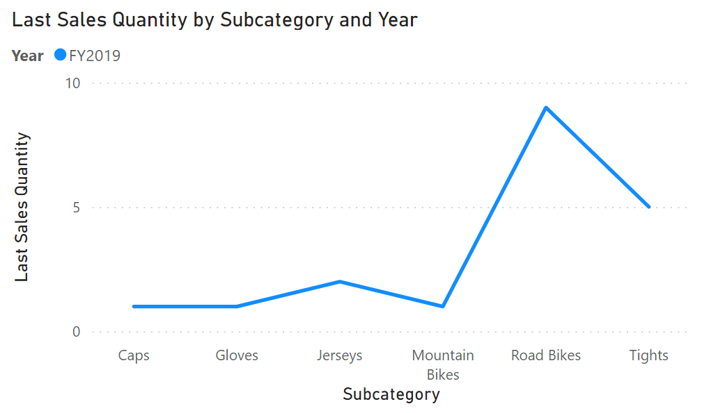
Semi-additive measures
Context-dependent: Results vary based on dimensions.
Time Intelligence: Useful for averages, ratios, balances.
Caution with aggregation: Beware of misleading results when aggregating.
Last Sales Quantity =
CALCULATE(
SUM(Sales[Quantity]),
LASTDATE('Date'[Date])
)
Notes:
Semi-additive measures are a powerful concept in Power BI when standard aggregation methods don't fit the data analysis requirements.
Our slide shows a semi-additive measure called "Last Sales Quantity," which calculates the quantity of sales for the last date within a selected time period. The line chart shows each subcategory’s quantity of sales for the last date in this year.
When would you want to use a semi-additive measure like this? Consider scenarios where you need to analyze inventory or sales data based on specific points in time rather than aggregating across all dates.
For example, if you want to understand the quantity of sales for the last day of each year or the last day of a selected time period, the "Last Sales Quantity" measure becomes invaluable.

Slide 9
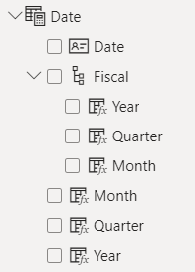
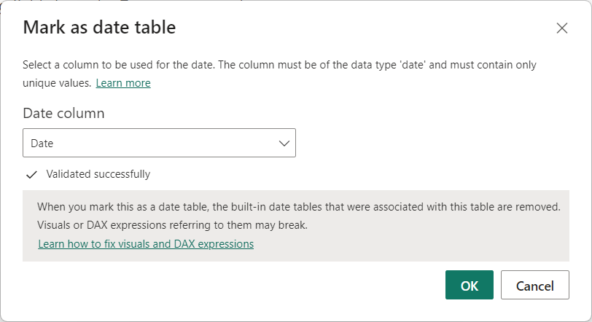
Create a common date table
Notes:
During Power BI report creation, it's often necessary to perform calculations based on date and time. To effectively analyze data over time, creating a date table is crucial. This table provides the necessary formatting for time-oriented values and allows businesses to track performance over months, quarters, fiscal years, and more.
Power BI includes an automatic date/time feature that generates predefined calculated columns for day, month, quarter, and year. However, these columns may not meet specific requirements or can unnecessarily increase model size. Disabling auto date/time doesn't eliminate the need for time intelligence. This is where a common date table comes into play.
Before creating a new common date table, it's advisable to check if there is already an existing one within the organization to avoid duplicating work.
A common date table allows you to standardize date formats and ranges according to company requirements. It can include additional details like company holidays, fiscal vs. calendar dates, and more. By adding month, week, and day number columns, you can filter and aggregate data based on various date types, simplifying complex calculations.
There are several ways to build a common date table:
Source data: Sometimes, source databases or data warehouses already have their own date tables.
DAX functions: You can use DAX functions like CALENDARAUTO() or CALENDAR() to generate a common date table.
Power Query: You can use the M-language in Power Query to define a common date table.
To designate the common date table as the official date table, you can right-click its name in the Fields pane and select "Mark as date table."

Slide 10
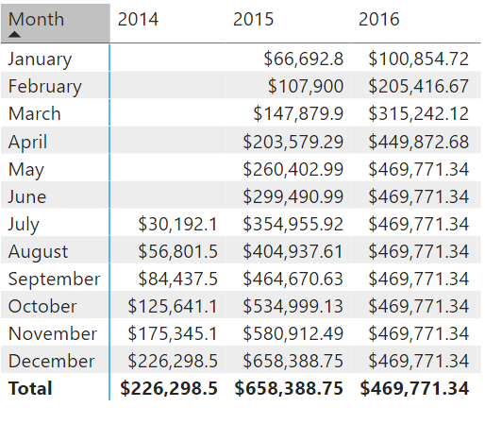
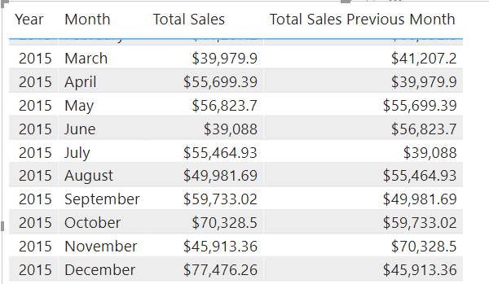
Time Intelligence functions
Total Sales Previous Month =
CALCULATE ( SUM ( Sales[Total Price] ), PREVIOUSMONTH ( 'Date'[Date] ) )
Notes:
All data analysts will have to deal with time. Dates are important, so we highly recommend that you create or import a dates table. This approach will help make date and time calculations much simpler in DAX.
While some time calculations are simple to do in DAX, others are more difficult. For instance, this screenshot shows what happens if you want to display a running total.
Notice that the totals increment for each month but then reset when the year changes. In other programming languages, this result can be fairly complicated, often involving several variables and looping through code.
<CLICK>
DAX makes this process fairly simple, for example, working with time to compare your current sales with the sales of a previous time period. For instance, if you want to see the total sales of the month next to the total sales of the prior month using the DAX CALCULATE() measure:
This measure uses the CALCULATE function, indicating that you're overriding the context to evaluate this expression the way that you want to. You're summing Total Price, as you've been doing throughout this module. For the second argument, you're using PREVIOUSMONTH for the override, which tells Power BI that, no matter what month is the default, the system should override it to be the previous month.
<CLICK>
Now see the new visual using the DAX measure. When you examine the months side-by-side, notice that the total sales for July compared to the total sales for June. Now you can also calculate the difference between current and previous months.

Slide 11
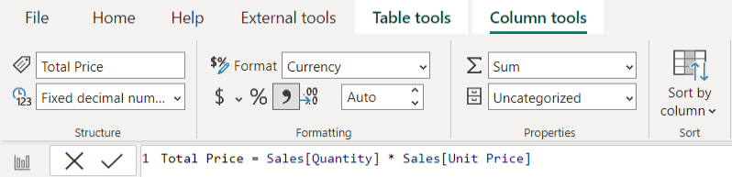
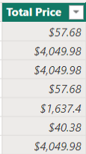

Create calculated columns
Defined using DAX expressions.
Computed & stored in data model.
Useful “helper/connector columns.”
Recalculated during data refresh.
Table and Sigma icon.
Notes:
A calculated column in Power BI is an extension of a table that uses a DAX formula to evaluate values for each row. It allows you to augment the data from different sources by creating a column that didn't originally exist.
For example, let's say you have a sales transaction table with columns like Order ID, Product ID, Quantity, and Unit Price. However, there's no column for the total sales amount per order. Using DAX, you can create a calculated column called Total Price by multiplying the Quantity and Unit Price values for each row.
To create a calculated column, select the ellipsis (...) button on the table in the Data pane and choose New column. Replace the default "Column =" text with the desired DAX expression, like:
Total Price = 'Sales OrderDetails'[Quantity] * 'Sales OrderDetails'[Unit Price]
Calculated columns are a type of custom column. You can create custom columns in three ways: in the source query, using Power Query, or by using DAX in Power BI.
Creating a calculated column in Power BI using DAX doesn't require semantic model refresh to see the changes, unlike the other methods. However, it's important to limit use of calculated columns due to potential performance impacts and increased data refresh time when dealing with large semantic models.

Slide 12
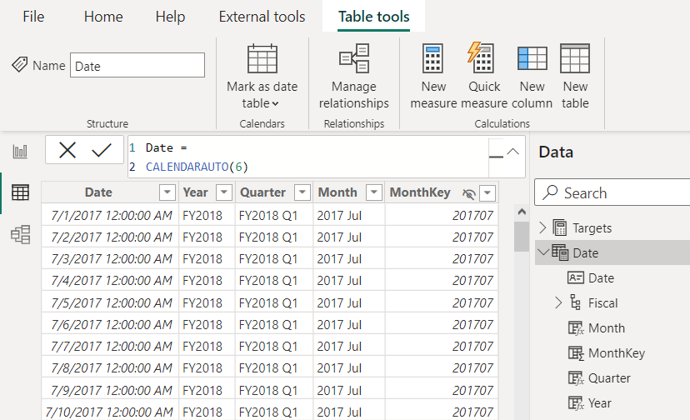
Create calculated tables
Defined using DAX expressions.
Computed & stored in data model.
Useful for aggregating data or creating custom tables.
Table and calculator icon.
Notes:
Calculated tables in Power BI are tables that are created based on DAX expressions or calculations. Unlike regular tables that store data, calculated tables are generated on the fly during query execution based on the defined DAX expressions. Calculated tables can be created manually by writing DAX expressions or by utilizing functions like CALENDARAUTO, as shown on this slide.
Calculated tables can be used to extend or enhance the data model by incorporating additional columns or performing complex calculations. They are useful in scenarios where you need to generate new tables based on existing data or perform calculations that are not easily achieved using regular measures.
By leveraging calculated tables, you can provide more flexibility and analytical capabilities to your reports and dashboards.

Slide 13
Calculated columns vs. measures
Calculated columns:
Measures:
Create values for each row in table.
Store values in the .pbix file.
Increases data model size.
Row-by-row calculation can impact performance.
Must be referenced with measures for reuse.
Calculate on demand.
Calculated based on filters.
Doesn’t affect data model size.
DAX expressions may still be suboptimal.
Can reference other measures directly for reuse.
Notes:
The fundamental difference between a calculated column and a measure is that a calculated column creates a value for each row in a table. For this reason, the calculated column can only operate over columns that exist in the same table. For example, if the table has 1,000 rows, it will have 1,000 values in the calculated column.
Calculated column values are stored in the Power BI .pbix file. Each calculated column will increase the space that is used in that file and potentially increase the refresh time.
Measures are calculated on demand. Power BI calculates the correct value when the user requests it. When you previously dragged the Total Sales measure onto the report, Power BI calculated the correct total and displayed the visual. Measures do not add to the overall disk space of the Power BI .pbix file.
Measures are calculated based on the filters that are used by the report user. These filters combine to create the filter context.
Ideally, you will create measures as needed. If you need a persisted column, consider creating a column in Power Query before choosing a calculated column for model optimization. That’s not to say that calculated columns are invaluable but use them sparingly.

Slide 14
Exercise
Create DAX calculations in Power BI Desktop
45 minutes
Notes:
https://aka.ms/mslearn-fabric-dax

Slide 15
Knowledge check: DAX calculations
Which statement about measures is correct?
Measures store values in the data model.
Measures can reference columns directly.
Measures can reference other measures directly.
Which of the following statements describing similarity of measures and calculated columns in an Import model is true?
They can achieve summarization of model data.
They store values in the data model.
They're evaluated during data refresh.

Slide 16
Recap
In this section, we covered:
The difference between implicit and explicit measures.
How to create different types of DAX formulas.
How filter context and CALCULATE function affect measures.
The differences between measures, calculated columns, and calculated tables.

Slide 17

Further reading
Add measures to Power BI Desktop models
https://aka.ms/power-bi-measures
Write DAX formulas for Power BI semantic models
https://learn.microsoft.com/training/modules/dax-power-bi-write-formulas
Notes:
Encourage students to review the online material on Microsoft Learn on which this presentation is based.

Slide 18
Design scalable semantic models
Notes:
https://aka.ms/fabric-scalable-models
Before delivering this presentation, review the associated module on Microsoft Learn.
The estimated time to present these slides is 75 minutes.

Slide 19
Learning objectives
Choose appropriate storage modes for your semantic model.
Enable large semantic model storage format and incremental refresh.
Create relationships between tables in a semantic model.
Design dynamic elements to extend calculations in a semantic model.
Notes:
Perhaps you've heard that Power BI can seamlessly handle trillions of rows of data, but you're not able to accomplish that in your own Power BI tenant. Working with high volume and large-scale data can be done in Fabric and Power BI with the right groundwork in place.
This section covers data modeling best practices and Microsoft Fabric features to design scalable semantic models. Large- or enterprise-scale data refers to table sizes from hundreds of thousands to millions of rows.
By the end, you'll be able to choose a model framework, design a star schema, and apply best practices to create a semantic model optimized for large-scale data analytics with Power BI.

Slide 20
Enterprise-scale data defined
Massive
Complex
Diverse
Rapid
Valuable
Enterprise-scale data: defined
Notes:
One of the keys to manageable, performant solutions with large data is good model design. We'll discuss model scalability, why it's important, and what tools exist in Power BI to help you and your team accomplish your goals.
What is enterprise or large-scale data?
Before we talk through scalability, let's define what we're talking about. Enterprise-scale data is data that is massive, complex, diverse, rapid, and valuable. It requires a unified data platform that can handle all the aspects of data analytics, from data movement to data science, in a scalable and cost-effective way. Microsoft Fabric is such a platform, which offers a lake-centric data warehouse, a serverless data integration service, and a comprehensive suite of data engineering and data science tools.
If you're familiar with working with enterprise data, it may be helpful to understand that Power BI is the next generation of Analysis Services. It's the same technology under the hood of Analysis Services and Power BI semantic models, the VertiPaq engine.

Slide 21
What is scalability and why is it important?
Flexibility
Models need to be able to accommodate change
Data growth
Models must be able to handle an increase in data volume with acceptable report performance
Reduced complexity
Models built with scalability in mind will be less complex and easier to manage
Notes:
Scalability in this context refers to building data models that can handle growth in the volume of data. A data model that ingests thousands of rows of data may grow to millions of rows over time, and the model must be designed to accommodate such growth. It's important to consider that your data will grow and/or change, which increases complexity.
Scalability must be at the forefront in enterprise solutions to ensure:
Flexibility - models need to be able to accommodate change
Data growth - models must be able to handle an increase in data volume with acceptable report performance
Reduced complexity - models built with scalability in mind will be less complex and easier to manage

Slide 22
How do I design for scalability?
Build with data modeling best practices in mind
Determine your needs for Direct Lake / Import / Direct Query
Enable large semantic model storage feature
Notes:
Beyond the data model, Microsoft Fabric was designed specifically for enterprise deployments. Premium/Fabric capacity offers greater storage capacity and allows for larger individual semantic models depending on the SKU. Implementing the Fabric only large semantic model storage feature (https://learn.microsoft.com/power-bi/enterprise/service-premium-large-models) enables data to grow beyond the Power BI desktop (.pbix) file size limitations.
Another important consideration in designing for scalability using Fabric is choosing the right capacity. You'll need to work with your Fabric administrator to determine which licensing SKU is available to you. If you're having performance issues in Fabric capacity, work first to optimize your model, and then work with your Power BI administrator to monitor Fabric capacities.
At the most basic level, it's important to understand that Fabric/Premium capacities require sufficient memory for processing. You'll need to double the amount of RAM to process your data model refresh. For example, if you have a 40-GB semantic model, you'll need at least 80-GB of memory available in the capacity.

Slide 23
Choose storage mode and design a model

Slide 24



Choose the best storage mode
Composite combines Import and DirectQuery.
Import
DirectQuery
Direct Lake
Stores data in Power BI.
Supports all transformations.
Requires data refreshes.
Connects to data source and only stores metadata in Power BI.
Supports limited transformations.
Stays up-to-date with source.
Connects to Fabric lakehouse.
Supports limited transformations.
Stays up-to-date with source.
Notes:
Build slide. Explain the three different modes shown, and then click to also explain Composite mode.
When designing a scalable semantic model, selecting the appropriate storage mode is crucial. Depending on your data source, you have four options: Import, DirectQuery, Direct Lake, and Composite model. Each mode has its own advantages and considerations to ensure optimal performance and scalability.
Import involves importing and storing data within Power BI, offering the most flexibility and fastest performance. However, it requires periodic refreshes to keep the data current, meaning the data is only as up-to-date as the last refresh.
Guidance for Import models also applies to the other storage modes. You should always choose Import, if your model allows. The primary goal is to reduce how much data you bring into the semantic model and how many transformations are performed within Power BI.
Optimization tips:
Connect to views instead of tables when working with relational databases.
Only include necessary tables, rows, and columns.
Consider partitioning and incremental refresh to avoid loading unnecessary data.
Use appropriate data types, such as integer for ID columns instead of string.
Ensure query folding, which reduces the work done within the Power BI engine.
DirectQuery allows you to query data directly from the source without storing it in Power BI, making it ideal for handling large volumes of data and near real-time data delivery. However, it has slower performance compared to Import Mode and offers limited modeling capabilities.
Optimization Tips:
Simplify DAX measures to avoid complex calculations at the source.
Apply dual storage mode for dimensions related to fact tables.
Use the Assume Referential Integrity property on relationships.
Avoid relationships on calculated and Unique Identifier columns.
Direct Lake allows querying data directly from a Microsoft Fabric lakehouse or warehouse without storing it in a semantic model, making it ideal for handling large volumes of data. This mode is optimized for quickly loading data into memory from Delta tables in Microsoft Fabric. While it offers the advantage of quick access to large data volumes, it requires the setup of a lakehouse or warehouse, and Delta tables and might need to be tuned for optimal performance.
Composite Mode mode can mix Import and DirectQuery modes, or integrate multiple DirectQuery data sources. This mode supports many-to-many relationships without the need for bridge tables. It offers the flexibility of querying and reporting capabilities by combining the benefits of both Import and DirectQuery modes. However, it requires periodic refreshes for Import mode tables and might have potential performance impacts when combining data from different sources.
Optimization Tips:
Ensure the back-end source has sufficient resources.
Minimize the number of literal values in source queries.
Keep the cardinality of columns used in relationships low.

Slide 25

Implement data modeling best practices
Prepare data upstream as much as possible.
Connect to views instead of tables when working with relational databases.
Include necessary tables, rows, and columns only.
Use Incremental refresh and partitioning to avoid loading unnecessary data.
Use appropriate data types, such as integer for ID columns instead of string.
Ensure query folding, which reduces the work done within the Power BI engine.
Notes:
Best practices for import mode:
Always start with import mode if you can.
Only bring in data you need.
Remove unnecessary rows and columns.
Only process what is absolutely necessary (tables/partitions) given the business requirements.
Avoid wide tables.
Use a star schema in Power BI.
If your source is a beautifully modeled data warehouse, you're a step ahead.
Big data is often in wide flat tables. Take advantage of dimensional models for their performance benefits.
Power BI supports multiple fact tables with different dimensionality and different granularities – you don’t have to put everything into one large table.
Pre-aggregate data before loading it to the model where possible.
Reduce the usage of calculated columns.
Data transformations requiring additional columns should be done as close to the source as possible.
Avoid high cardinality columns.
Consider breaking a datetime column into two columns, one for date and one for time.
Use appropriate data types.
Use integers instead of strings for ID columns.
Use surrogate keys for ID columns if necessary.
Limit the use of bi-directional filters on relationships.
Disable auto date/time.
Connect to a date table at the source or create your own date table.
Disable attribute hierarchies for non-attribute columns.
If querying a relational database, query database views rather than tables.
A view provides an abstraction layer to manage columns, and relates back to the first consideration, pushing transformations as close to the source as possible.
Views shouldn't contain logic. They should only contain a SELECT statement from a table.
Consider partitioning and incremental refresh to avoid loading data you don’t need to.
Check to ensure query folding is achieved.
If query folding isn't possible, you have another opportunity to work with the data engineer to move transformation upstream.
Best practices specific to DirectQuery mode:
Set relationships to enforce integrity using the Assume referential integrity property on relationships.
The Assume Referential Integrity setting on relationships enables queries to use INNER JOIN statements rather than OUTER JOIN.
Limit the use of bi-directional filters on relationships.
Use only when necessary.
Limit the complexity of DAX calculations.
Because query folding occurs by default in DirectQuery, more complex DAX measures means added complexity at the source, leading to slow queries.
The need for complex DAX also leads back to the key principle of applying transformations as far upstream as possible. You may need to work with the data engineer to apply transformations at the source.
Avoid the use of calculated columns.
Transformations requiring additional columns should be done as far upstream as possible, particularly when using DirectQuery.
Avoid relationships on calculated columns
Avoid relationships on Unique Identifier columns
Use dual storage mode for dimensions related to fact tables that are in DirectQuery.

Slide 26
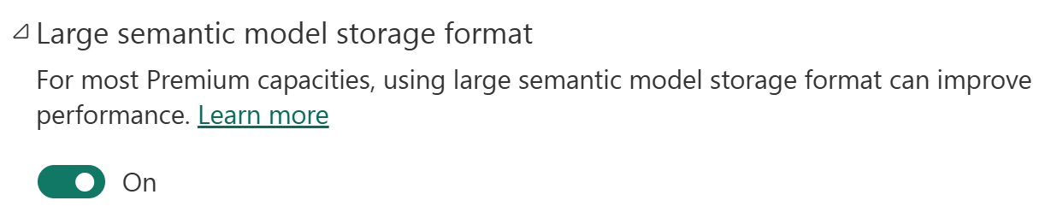
Enable large semantic model storage format
Allows models to grow beyond the default 10-GB limit.
Semantic model sizes limited only by the capacity size or a maximum size set by the admin.
Requires Fabric or Premium capacity.
Notes:
Power BI semantic models store data in a highly compressed, in-memory cache for optimized query performance. Enterprise deployment of an analytics solution using Power BI will likely require Power BI Premium. With the large semantic model storage format enabled, semantic model sizes are limited only by the capacity size, or a maximum size set by the administrator. This differs from semantic models in Power BI, which are limited to 10 GB after compression if large semantic model storage format isn't enabled.
Large semantic models can be enabled for workspaces with Fabric capacities or Premium Per User (PPU). Enabling the large semantic model format enables fast user interactivity and allows data to grow beyond the 10-GB limit.
To use large semantic model storage format, the semantic model must be stored in a workspace that allocated to Fabric or Premium capacity.
Important note: semantic models enabled for large models can't be downloaded as a Power BI Desktop (.pbix) file from the Power BI service. Read more about .pbix download limitations.
If your semantic model continues growing larger and progressively consumes more memory, be sure to configure Incremental refresh.

Slide 27
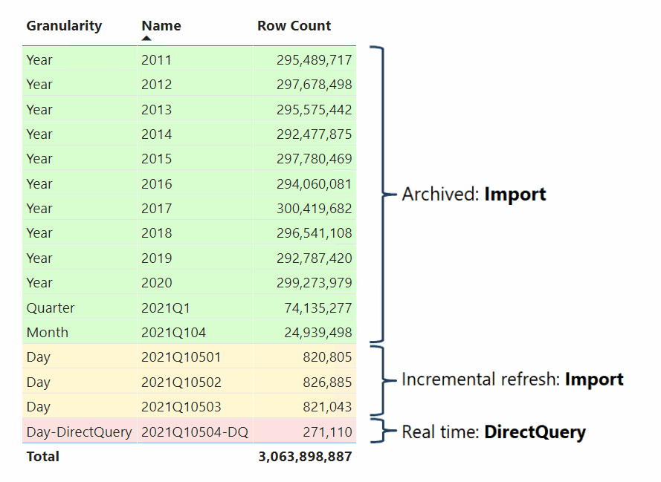
Incremental refresh and partitioning
Hybrid table
Incremental refresh
Configure parameters in Power Query
Configure refresh policy
Data refreshes changes based on parameters
Partitioning
Divide table into smaller segments
Refresh on demand
Configure via tools like SSMS or Tabular Editor
Notes:
When working with very large data sources, you need a different data loading strategy. Let’s review incremental refresh, partitioning, and how these strategies work for hybrid tables.
Incremental refresh
Incremental refresh allows you to refresh only the data that has changed or been added since the last refresh. This feature reduces the time and resources required for data refreshes, making it ideal for frequently updated large data sources.
Suppose your sales table is incredibly large and takes a long time to refresh the semantic model. If you need to keep the data up-to-date, then you can configure Incremental refresh to only refreshing the new and updated transactions.
To enable incremental refresh, you first need to define parameters and filter the row using the parameters in Power Query. Once applied, you configure the Incremental refresh policy on the table in Power BI Desktop. You can optionally configure the table to get the latest data with DirectQuery. To take advantage of this feature, your semantic model must be published to a supported Fabric workspace.
Partitioning
Incremental refresh focuses on refreshing only the changed or new data, whereas partitioning involves dividing the entire table into smaller segments. Partitioning involves dividing a large table into smaller, more manageable pieces called partitions. Each partition can be processed independently, which can improve query performance and manageability.
For example, you could create partitions for each month or quarter on your sales table, allowing queries to target specific partitions rather than the entire semantic model.
To enable partitioning, you can use tools like SQL Server Management Studio (SSMS) or Tabular Editor.
Hybrid tables
A hybrid table can help to strike the right balance between query performance and data freshness.
A hybrid table is essentially a (large) table that has one or multiple import-mode partitions as well as another partition in DirectQuery mode.
If the DirectQuery partition is sufficiently small in comparison to the import-mode partitions, the query/response roundtrips between Power BI and the data source should still be reasonably fast while access to the bulk of the data is already super-fast in import mode. Import and DirectQuery data is presented to users as a single table with business definitions and calculations.

Slide 28
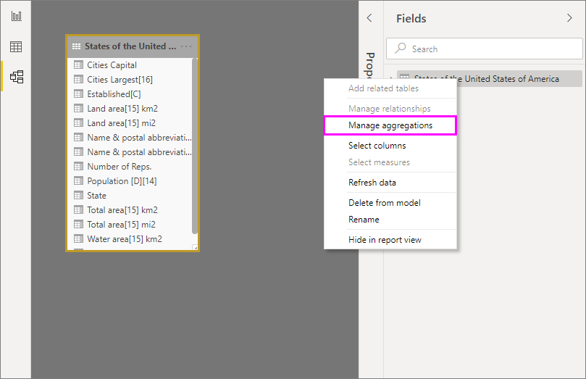
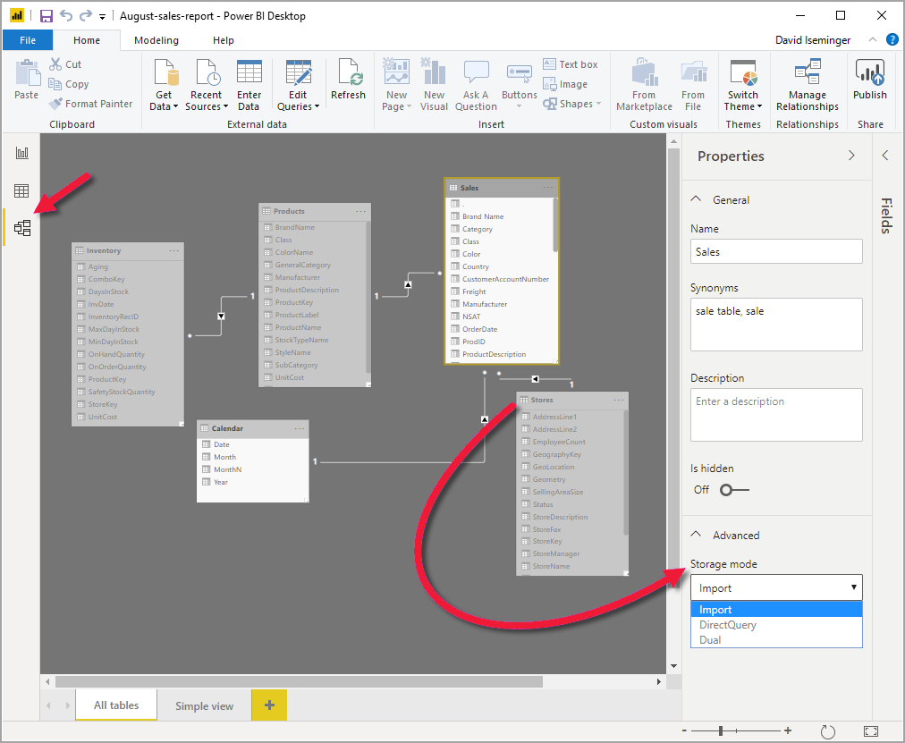
Additional storage mode configurations
Aggregations
Dual storage mode
Notes:
This is a build slide.
Aggregations
Aggregations in Power BI can improve query performance over very large DirectQuery semantic models. By using aggregations, you cache data at the aggregated level in-memory. Aggregations in Power BI can be manually configured in the data model, as described in this article, or for Premium subscriptions, automatically by enabling the Automatic aggregations feature in semantic model Settings.
Dual storage mode
In Power BI Desktop, you can specify the storage mode of a table. The storage mode lets you control whether Power BI Desktop caches table data in-memory for reports.
Setting the storage mode provides many advantages. You can set the storage mode for each table individually in your model.
Benefits:
Query performance: As users interact with visuals in Power BI reports, Data Analysis Expressions (DAX) queries are submitted to the semantic model. Caching data into memory by properly setting the storage mode can boost the query performance and interactivity of your reports.
Large semantic models: Tables that aren't cached don't consume memory for caching purposes. You can enable interactive analysis over large semantic models that are too large or expensive to completely cache into memory. You can choose which tables are worth caching, and which aren't.
Data refresh optimization: You don't need to refresh tables that aren't cached. You can reduce refresh times by caching only the data that's necessary to meet your service level agreements and your business requirements.
Near-real time requirements: Tables with near-real time requirements might benefit from not being cached, to reduce data latency.
Writeback: Writeback enables business users to explore what-if scenarios by changing cell values. Custom applications can apply changes to the data source. Tables that aren't cached can display changes immediately, which allows instant analysis of the effects.
Set the Storage mode property to one of these three values:
Import: Imported tables with this setting are cached. Queries submitted to the Power BI semantic model that return data from Import tables can be fulfilled only from cached data.
DirectQuery: Tables with this setting aren't cached. Queries that you submit to the Power BI semantic model—for example, DAX queries—and that return data from DirectQuery tables can be fulfilled only by executing on-demand queries to the data source. Queries that you submit to the data source use the query language for that data source, for example, SQL.
Dual: Tables with this setting can act as either cached or not cached, depending on the context of the query that's submitted to the Power BI semantic model. In some cases, you fulfill queries from cached data. In other cases, you fulfill queries by executing an on-demand query to the data source.
Changing the Storage mode of a table to Import is an irreversible operation. Once set, this property can't later be changed to either DirectQuery or Dual.

Slide 29
Work with relationships

Slide 30
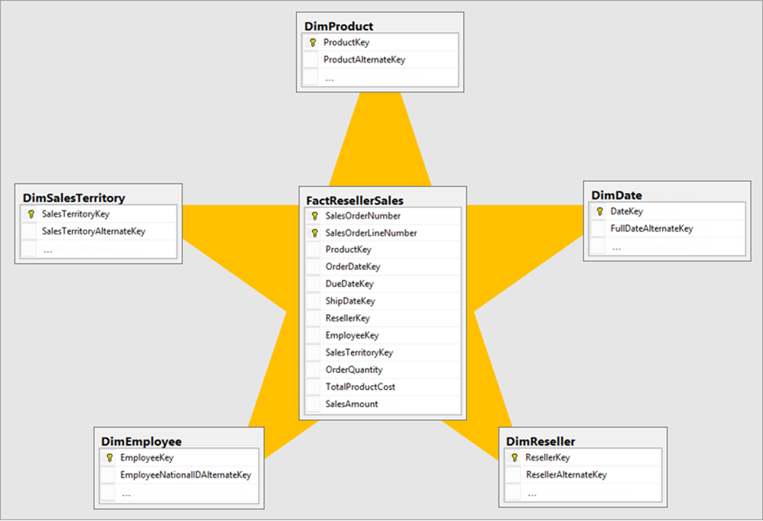
Apply star schema design principles
Fact table connected to dimension tables with relationships.
Dimension tables change less frequently.
Also known as dimensional modeling.
Notes:
We recommend you apply star schema design principles to produce a model comprising dimension and fact tables. It’s common to set up Power BI to enforce rules that filter dimension tables, allowing model relationships to efficiently propagate those filters to fact tables.
The following image is the model diagram of the Adventure Works sales analysis data model. It shows a star schema design comprising a single fact table named FactResellerSales. The other five tables are dimension tables that support the analysis of sales measures by product, date, reseller, employee, and sales territory.
Relationships are then used to connect all dimension tables to the fact table. These relationships propagate filters (directly or indirectly) from the dimension table to the FactResellerSales table.
Use disconnected tables
It's unusual that a model table isn't related to another model table. Such a table in a valid model design is described as a disconnected table. A disconnected table isn't intended to propagate filters to other model tables. Instead, it accepts "user input" (perhaps with a slicer visual), allowing model calculations to use the input value in a meaningful way. For example, consider a disconnected table that’s loaded with a range of currency exchange rate values. As long as a filter is applied to filter by a single rate value, a measure expression can use that value to convert sales values.

Slide 31
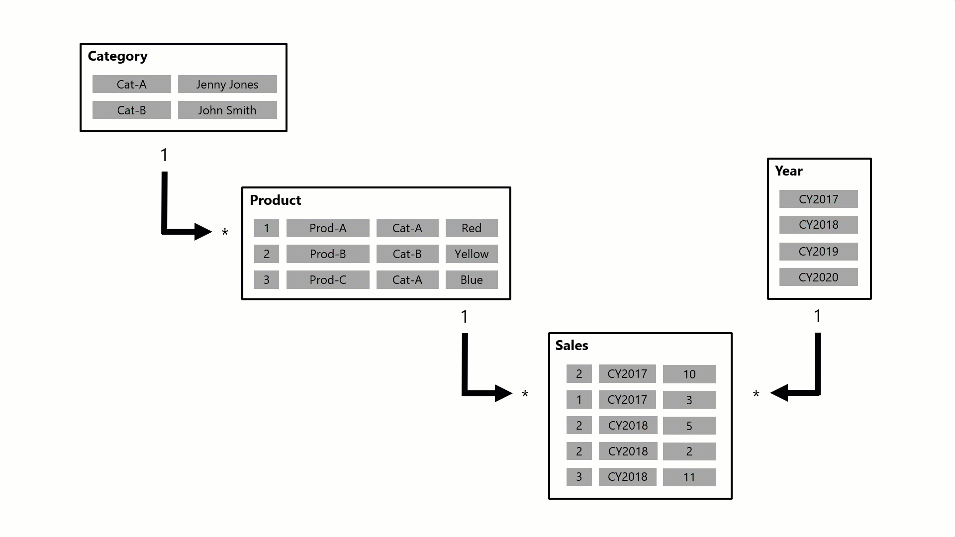
Understand model relationships
Notes:
This is an animated diagram that shows a business question and how the filtering through the dimension tables identifies the value to provide answer.
A model relationship propagates filters applied on the column of one model table to a different model table. Filters will propagate so long as there's a relationship path to follow, which can involve propagation to multiple tables.
Relationship paths are deterministic, meaning that filters are always propagated in the same way and without random variation. Relationships can, however, be disabled, or have filter context modified by model calculations that use particular DAX functions.
In this example, the model consists of four tables: Category, Product, Year, and Sales. The Category table relates to the Product table, and the Product table relates to the Sales table. The Year table also relates to the Sales table. All relationships are one-to-many.

Slide 32
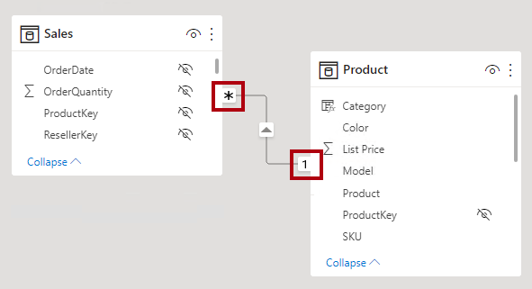
Set up relationships
Set relationship cardinality and cross-filter direction
Cardinality type | Cross filter options
One-to-many (or many-to-one) | Single Both
One-to-one | Both
Many-to-many | Single (Table1 to Table2) Single (Table2 to Table1) Both
Notes:
A model relationship relates one column in a table to one column in a different table. (There's one specialized case where this requirement isn't true, and it applies only to multi-column relationships in DirectQuery models.)
Note: It's not possible to relate a column to a different column in the same table. This concept is sometimes confused with the ability to define a relational database foreign key constraint that’s table self-referencing. You can use this relational database concept to store parent-child relationships (for example, each employee record is related to a "reports to" employee). However, you can’t use model relationships to generate a model hierarchy based on this type of relationship. To create a parent-child hierarchy, see Parent and Child functions.
In Power BI Desktop model view, you can interpret a relationship's cardinality type by looking at the indicators (1 or *) on either side of the relationship line. To determine which columns are related, you'll need to select, or hover the cursor over, the relationship line to highlight the related columns.

Slide 33
Use DAX relationship functions
There are several DAX functions that are relevant to model relationships:
RELATED
RELATEDTABLE
USERELATIONSHIP
CROSSFILTER
COMBINEVALUES
TREATAS
Parent and child functions
Notes:
Relationship functions can be used for managing and utilizing relationships between tables, even inactive relationships.
RELATED
Returns a related value from another table.
RELATEDTABLE
Evaluates a table expression in a context modified by the given filters.
USERELATIONSHIP
Specifies the relationship to be used in a specific calculation as the one that exists between columnName1 and columnName2.
CROSSFILTER
Specifies the cross-filtering direction to be used in a calculation for a relationship that exists between two columns.
COMBINEVALUES
Joins two or more text strings into one text string.
TREATAS
Applies the result of a table expression as filters to columns from an unrelated table.
Parent and child functions
Help users manage data that is presented as a parent-child hierarchy in their models. Use these functions to:
Obtain the entire lineage of parents a row has
How many levels has the lineage to the top parent
Who is the parent n-levels above the current row
Who is the n-descendant from the top of the current row hierarchy
Is certain parent a parent in the current row hierarchy?

Slide 34
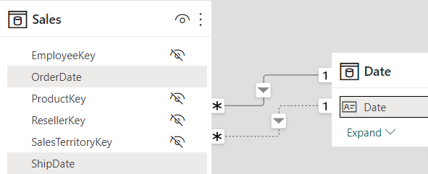
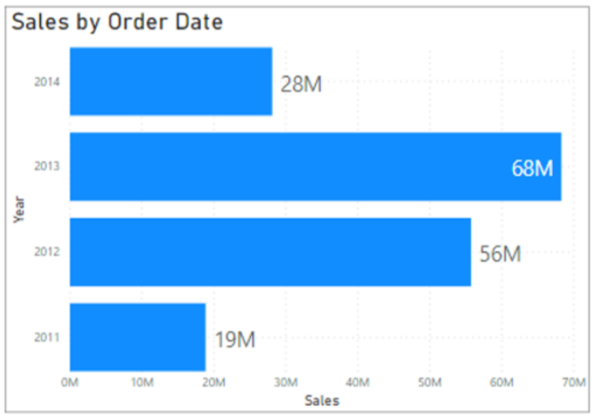
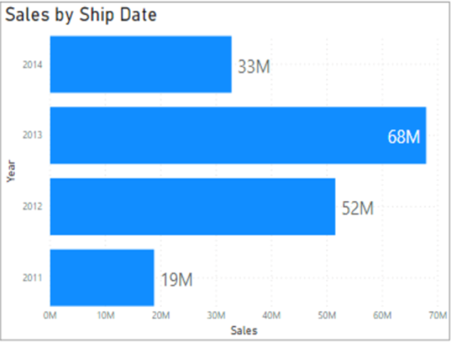
Use inactive relationships with DAX
Enable additional table filtering without impacting the active relationship.
Sales by Ship Date =
CALCULATE (
Sales[TotalPrice],
USERELATIONSHIP (
'Calendar'[Date], Sales[ShipDate])
)
Notes:
<BUILD slide>
Earlier when we discussed role-playing dimensions, we explained that you can create multiple relationships between tables, but only one could be active. In order to leverage the inactive relationships, you need to use DAX. This is the final step in creating role-playing dimensions.
In this image, we see the Sales and Date tables, with two relationships. The active relationship is between OrderDate and Date.
<CLICK>
We can see that we can filter by date to calculate sales. However, if we also wanted to visualize the data by ShipDate, then we need to use DAX.
<CLICK>
To enable filtering on ShipDate, you can use the DAX function USERELATIONSHIP(). This function is used to specify a relationship to be used in a specific calculation and is done without overriding any existing relationships. It is a beneficial feature in that it allows developers to make additional calculations on inactive relationships by overriding the default active relationship between two tables in a DAX expression, as shown in the following example:
Sales by Ship Date = CALCULATE(Sales[TotalPrice], USERELATIONSHIP('Calendar'[Date], Sales[ShipDate]))
Now, you will be able to create the bottom visual.

Slide 35
Understand relationship evaluation
We can understand relationship evaluation through:
Regular relationships
Limited relationships
Precedence rules
Performance preference
Notes:
Model relationships, from an evaluation perspective, are classified as either regular or limited. It's not a configurable relationship property. It’s inferred from the cardinality type and the data source of the two related tables. It's important to understand the evaluation type because there may be performance implications or consequences should data integrity be compromised.
Regular relationships
A model relationship is regular when the query engine can determine the "one" side of relationship. It has confirmation that the "one" side column contains unique values. All one-to-many intra source group relationships are regular relationships.
Limited relationships
A model relationship is limited when there's no guaranteed "one" side. A limited relationship can happen for two reasons:
The relationship uses a many-to-many cardinality type (even if one or both columns contain unique values).
The relationship is cross source group (which can only ever be the case for composite models).
Precedence rules
Bi-directional relationships can introduce multiple, and therefore ambiguous, filter propagation paths between model tables. The following list presents precedence rules that Power BI uses for ambiguity detection and path resolution:
Many-to-one and one-to-one relationships, including limited relationships
Many-to-many relationships
Bi-directional relationships, in the reverse direction (that is, from the "many" side)
Performance preference
The following list orders filter propagation performance, from fastest to slowest performance:
One-to-many intra source group relationships
Many-to-many model relationships achieved with an intermediary table and that involve at least one bi-directional relationship
Many-to-many cardinality relationships
Cross source group relationships

Slide 36
Write DAX for readability with complex calculations

Slide 37
Use variables to improve performance and readability
Without variable:
Sales YoY Growth =
DIVIDE (
( [Sales] - CALCULATE ( [Sales], PARALLELPERIOD ( 'Date'[Date], -12, MONTH ) ) ),
CALCULATE ( [Sales], PARALLELPERIOD ( 'Date'[Date], -12, MONTH ) ) )
With variable:
Sales YoY Growth =
VAR SalesPriorYear = CALCULATE ( [Sales], PARALLELPERIOD ( 'Date'[Date], -12, MONTH ) )
VAR SalesVariance = DIVIDE ( ( [Sales] - SalesPriorYear ), SalesPriorYear )
RETURN
SalesVariance
Notes:
You can use variables in your DAX formulas to help you write less complex and more efficient calculations. Variables are underused when starting with Power BI Desktop, but they are effective, and a great habit to create when you are creating measures.
Some expressions involve the use of many nested functions and the reuse of expression logic. These expressions take a longer time to process and are difficult to read and, therefore, troubleshoot.
If you use variables, you can save query processing time. This change is a step in the right direction toward optimizing the performance of a data model.
The use of variables in your data model provides the following advantages:
Improved performance
Improved readability
Simplified troubleshooting code
Reduced complexity

Slide 38
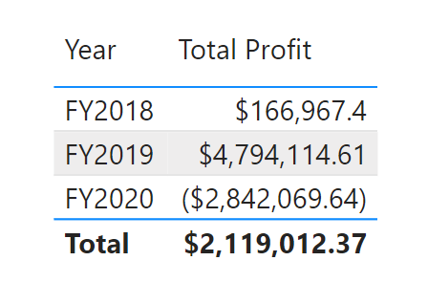
Iterator functions
Calculates row-by-row to return a single value.
Might affect performance for large amounts of data.
Total Profit =
SUMX(
Sales,
Sales[Quantity] * (Sales[Sales] - Sales[Cost])
)
Notes:
Iterators
Iterator functions in DAX, such as SUMX, AVERAGEX, and MAXX, perform row-by-row calculations over a table and return a single value. These functions are useful for performing calculations that depend on the context of each row. Be cautious using iterator functions for large amounts of data due to the row-by-row processing, which can affect performance.
The example shows how to calculate the total profit for each product.

Slide 39
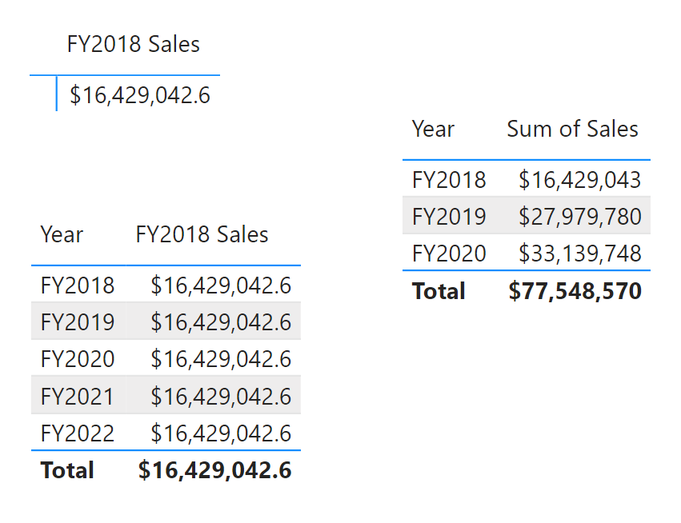
Table filtering functions
Create filtered tables.
Can override default filter context.
FY2018 Sales = SUMX(
CALCULATETABLE(
'Sales',
'Date'[Year] = "FY2018"
),
[Sales]
)
Notes:
Table Filtering
Table filtering functions, such as FILTER, ALL, and CALCULATETABLE, allow you to create filtered tables based on specific conditions. These functions are useful for creating dynamic calculations that depend on the filtered context.
The example shows how to calculate the total sales for a specific year.
The CALCULATETABLE function modifies the filter context to include only the sum of Sales for FY2018 year value.
As a result, when using this measure in a table with multiple year values, each value for the FY2018 measure is the same.
However, you can see in the Year and Sum of Sales table that each year has a different sales amount.
These table filtering functions help you create dynamic and context-sensitive calculations, enabling more precise and insightful data analysis.

Slide 40
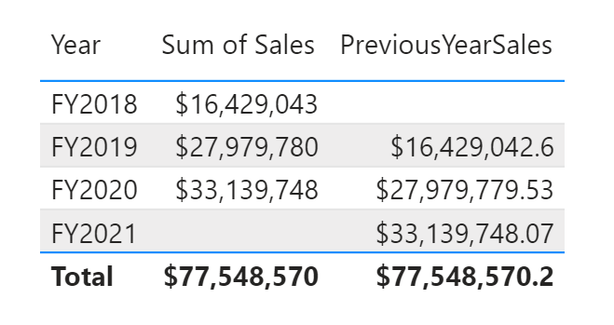
Windowing functions
Calculate in a specific window of data.
Useful for rankings and running totals.
PreviousYearSales =
CALCULATE (
SUM ( Sales[Sales] ),
OFFSET (
-1,
,
ORDERBY ( 'Date'[Year], ASC ),
)
)
Notes:
Windowing Functions
Windowing functions in DAX, such as INDEX, OFFSET, and WINDOW, allow you to perform calculations over a specified window of data. These functions are useful for creating rankings, running totals, and other calculations that depend on the order of data.
The example shows how to compare the sales of the current year with the previous year.
In this example, the OFFSET function is used to shift the context to the previous row based on the order of the Date[Year] column.
This allows you to compare the sales amount of the current year with the previous one, which can be useful for trend analysis and other comparative calculations.

Slide 41
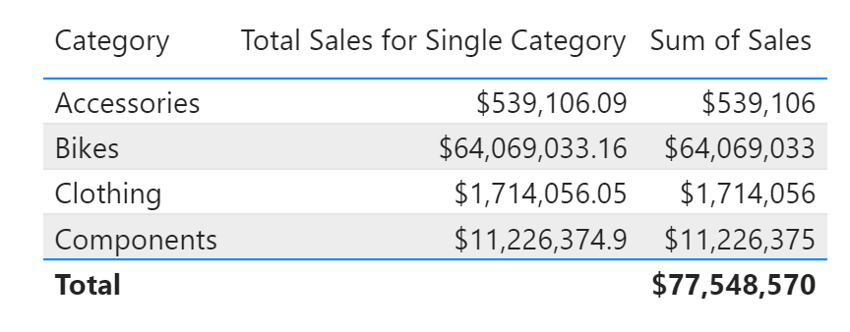
Information functions
Perform checks and applies a condition to resulting value.
Use with IF to control results.
Total Sales for Single Category =
IF(
HASONEVALUE(Product[Category]),
SUM(Sales[Sales]),
BLANK()
)
Notes:
Information Functions
Information functions, such as ISBLANK, ISNUMBER, and CONTAINS, allow you to perform checks and return information about the data. These functions are useful for creating conditional calculations and handling special cases. This is useful in scenarios where you want to perform calculations only when a single value is selected in a filter context.
The examples shows how to calculate the total sales amount only if a single product category is selected.
The HASONEVALUE function checks if there is only one distinct value in the Products[Category] column.
If a single category is selected, the formula calculates the total sales amount, and if more than one category is selected, the formula returns BLANK().

Slide 42
Create dynamic calculation elements

Slide 43
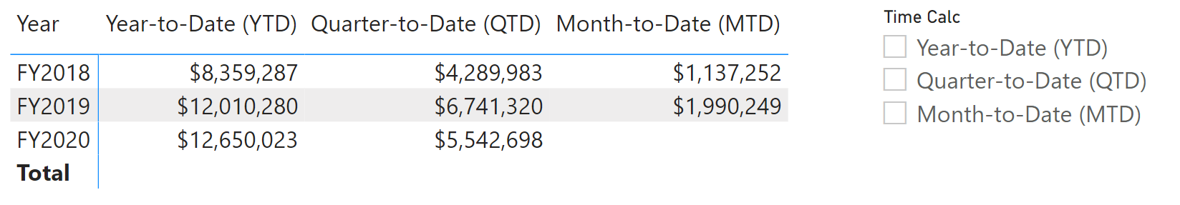
Calculation groups
Reusable calculations across other measures.
Contextual to measure included in a matrix visual.
Can be used in other measures also.
Year-to-Date (YTD) =
CALCULATE(
SELECTEDMEASURE(),
DATESYTD('Date'[Date])
)
//
Quarter-to-Date (QTD) =
CALCULATE(
SELECTEDMEASURE(),
DATESQTD('Date'[Date])
)
//
Month-to-Date (MTD) =
CALCULATE(
SELECTEDMEASURE(),
DATESMTD('Date'[Date])
)
Notes:
Build slide. Click to fly in the table and slicer visuals image.
Calculation groups allow you to define reusable calculations that apply across multiple measures, which reduce redundancy and simplifies the maintenance of your semantic models. You can use calculation groups to streamline complex calculations, such as time intelligence functions, across your entire model.
Consider you need to calculate Year-to-Date (YTD), Quarter-to-Date (QTD), and Month-to-Date (MTD) sales data. Instead of creating separate measures for each time intelligence function, you decide to use calculation groups to streamline these calculations.
For this example, we have a calculation group called Time Calc with three separate calculation items. The calculation group column includes all items for the group to be used in visuals. We included a slicer for the calculation group column, so you can choose which values to see.

Slide 44
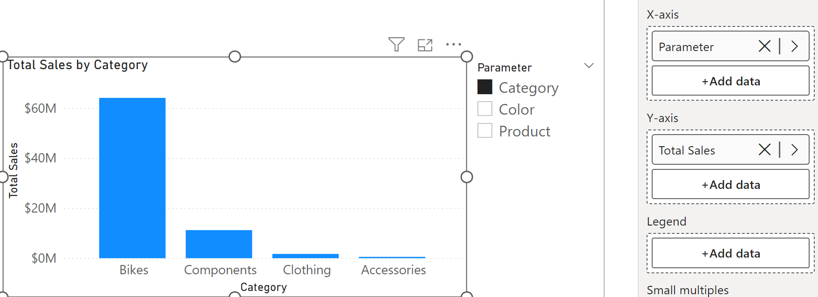
Field parameters
Single item that can be used in a visual well, which includes multiple fields.
Use in a slicer to control dynamic switching between fields.
Notes:
Field parameters allow you to create interactive reports by enabling users to select different fields or measures dynamically. This feature is useful for creating customizable reports where users can choose the data they want to see.
In our scenario, we created a new parameter to include the Product, Category, and Color fields. Now we use our Total Sales measure and add the parameter in a visual instead of those individual fields. We also add a slicer with the parameter so users can switch between the selected fields.
The image shows a column chart for Total Sales by Category configured with the parameter in the X-axis and Total Sales in the Y-axis. A slicer is also present to dynamically switch between the Total Sales by Product, Category, and Color.
Before field parameters, report developers might create a visual for Total Sales by Product and repeat for Category and Color. Users could switch between the different visuals in a similar experience by overlaying the visuals on top of each other and adding bookmarks and buttons. However, the more visuals you add to a report page might affect performance.

Slide 45
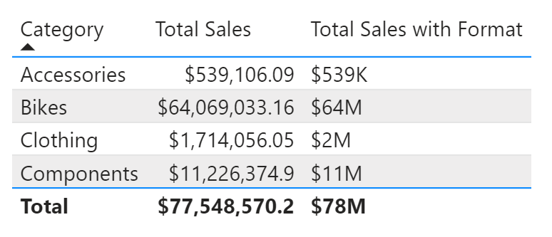
Dynamic format strings
Consider you want to conditionally format sales figures based on their value:
Millions (M) for sales over 1,000,000.
Thousands (K) for sales between 1,000 and 1,000,000.
Exact value for sales under 1,000.
Total Sales with Format =
SWITCH(
TRUE(),
[Total Sales] > 1000000, FORMAT([Total Sales], "$#,##0,,M"),
[Total Sales] > 1000, FORMAT([Total Sales], "$#,##0,K"),
FORMAT([Total Sales], "$#,##0")
)
Notes:
Build slide. Click to fly in the table image with Total Sales and Total Sales with Format comparison.
Dynamic format strings let you adjust the format of a measure based on conditions, improving data readability and presentation.
Dynamic format strings simplify your data presentation, reducing the need for multiple calculations or visuals, and can be used with calculation groups to reduce complexity and maintenance for your code.

Slide 46
Exercise
Design a scalable semantic model
30 minutes
Notes:
https://aka.ms/mslearn-fabric-scalable-models The estimated time to complete this exercise is 30 minutes.

Slide 47
Knowledge check
1
What is the most efficient approach for data transformation when designing semantic models for scalability?
Data transformation should always be done using Power Query in Power BI.
Data transformation should be done as close to the source as possible, before reaching Power BI.
Data transformation should be done using DAX, after data is ingested and loaded to the model.
2
Which of the following best practices for Power BI data modeling is relevant only to DirectQuery models?
Set relationships to enforce integrity using the assume referential integrity property on relationships.
Use a star schema as opposed to wide tables.
Disable auto date/time in Power BI Desktop.
3
What are the size limits when large semantic model storage format is turned on?
Power BI 10 GB size limit.
Fabric capacity size or the maximum size set by the administrator.
There are no size limits if large semantic model storage format is enabled.
Notes:
Allow students a few minutes to think about the questions, and then use the animated slide to reveal the correct answers.

Slide 48
Recap
In this section, we covered:
How to choose storage mode and frameworks for scalability.
Different relationships and ways they affect data filtering.
DAX variables and functions to improve readability and efficiency.
Dynamic calculation elements for reusability and performance.

Slide 49
Further reading
Design scalable semantic models
https://aka.ms/fabric-scalable-models
Power BI usage scenarios: advanced data model management
https://aka.ms/model-management
Notes:
Encourage students to review the online material on Microsoft Learn on which this presentation is based.

Slide 50
Optimize a model for performance in Power BI
Notes:
aka.ms/optimize-power-bi
Before delivering this presentation, review the associated module on Microsoft Learn.
The estimated time to present these slides is 45 minutes.

Slide 51
Learning objectives
Review the performance of measures, relationships, and visuals.
Improve performance by reducing cardinality levels.
Optimize DirectQuery models with table level storage.
Create and manage aggregations.

Slide 52
Optimize Power BI solutions
Data source(s)
Data model
Visualizations
Environment
Notes:
We’ve just learned about how to design semantic models with scalability in mind. While this is critical for enterprise data, it’s valuable for all data solutions. When facing performance issues, the first thing you should do is to verify that all of the guidance is already in place.
For instance, if you have a fact table with billions of rows that is connected via DirectQuery, you’re likely affecting the database performance due to unnecessary long-running queries every time users interact with the visuals using that data. Additionally, make sure that you only include necessary data, data types are correct, and relationships are configured correctly.
You can optimize your solution at different architectural layers. Layers include:
The data source(s)
The data model
Visualizations, including dashboards, Power BI reports, and Power BI paginated reports
The environment, including capacities, data gateways, and the network
The data model supports the entire visualization experience. Data models are either external-hosted or internal-hosted, and in Power BI they are referred to as semantic models. It's important to understand your options, and to choose the appropriate semantic model type for your solution: import v DirectQuery v Composite.
You can optimize the Power BI environment by configuring capacity settings, sizing data gateways, and reducing network latency.

Slide 53
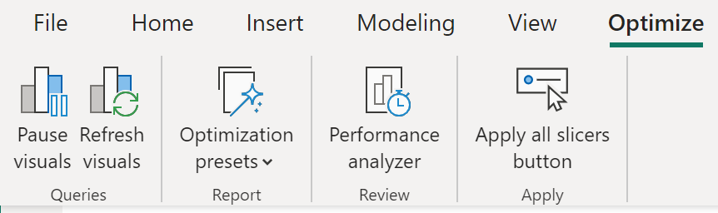
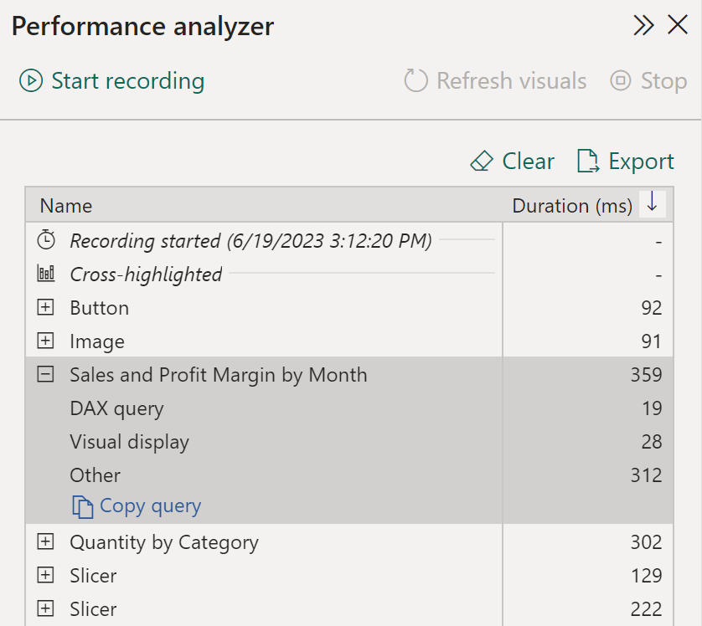
Tune report performance
Performance analyzer in Power BI Desktop
Record report interactions.
Review query and rendering times.
Identify bottlenecks, optimize queries.
Notes:
When you have completed creating your report, the performance of that report depends on how quickly data can load onto the report page. You should test out your report in the Power BI service, to see how it works from an end-user perspective. If you experience any issues yourself, or if the report users have reported issues, you need to investigate the cause of those issues, and take measures to tune the report for more optimized performance.
Analyze Performance:
To investigate the cause of issues, your first port of call is the Performance analyzer tool within Power BI Desktop. Performance analyzer allows you to find out how each of your report elements and provides you with logs which measure (in time duration) how each of your report elements performs when users interact with them. By looking closely at the durations in the logs, you can identify which elements of the report are the most (or least) resource intensive. You can find where the bottlenecks are and this gives you a good starting point for making changes.
Before you run Performance analyzer, ensure you clear the visual cache and data engine cache, otherwise the results will not be accurate. Also, you should set up the report so that it opens on a blank page.
When you have cleared the caches, and opened the report on the blank page, to run the Performance analyzer, go to View tab, select Performance analyzer, and then select Start Recording.
Interact with your report as you would expect a user to, then stop the recording. You will see the results of your interactions displaying in the Performance analyzer pane as you work. When you are finished, select the Stop button. You can then analyze the results in the Performance analyzer pane. You will see the performance results of each item in the report, in milliseconds, under the Duration column.
You can review the results of your performance test in the Performance analyzer pane. To review the tasks in order of duration, longest to shortest, right-click the Sort icon next to the Duration (ms) column header, and then select Total time in Descending order.
The log information for each visual shows how much time it took (duration) to complete the following categories of tasks:
DAX query - The time it took for the visual to send the query, along with the time it took Analysis Services to return the results.
Visual display - The time it took for the visual to render on the screen, including the time required to retrieve web images or geocoding.
Other - The time it took the visual to prepare queries, wait for other visuals to complete, or perform other background processing tasks. If this category displays a long duration, the only real way to reduce this duration is to optimize DAX queries for other visuals, or reduce the number of visuals in the report.
The results of the analysis test help you to understand the behavior of your data model and identify the elements that you need to optimize. You can compare the duration of each element in the report and identify the elements that have a long duration. You should focus on those elements and investigate why it takes them so long to load on the report page.
Metadata
Metadata is information about other data. Power BI metadata contains information on your data model, such as the name, data type and format of each of the columns, the schema of the database, the report design, when the file was last modified, the data refresh rates, and much more.
You can use Power Query Editor in Power BI Desktop to examine the columns, rows, and values of the raw data. You can then use the available tools, such as those highlighted in the following screenshot, to make the necessary changes.
Tune Performance:
The results of your analysis will identify areas for improvement and highlight items that you need to optimize.
A common reason for poor performance is too many visuals on the same page. In the following image you can see an example of a busy page that contains many visuals.
If you identify visuals as the bottleneck leading to poor performance, you can take the following steps to tune the report:
Reduce the number of visuals on the report page; fewer visuals means better performance. If a visual is not necessary and does not add value to the end user, should remove it. Rather than using multiple visuals on the page, consider other ways to provide additional details, such as drillthrough pages and report page tooltips.
Reduce the number of fields in each visual. The upper limit for visuals is 100 fields, so a visual with more than 100 fields will be slow to load (and look cluttered and confusing). Identify fields that are not valuable to the visual and remove them.
If you find that visuals are not causing the performance issues, you should take a close look at the DAX Query results that are displayed in the Performance analyzer pane, and investigate further into those.

Slide 54
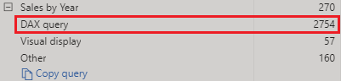
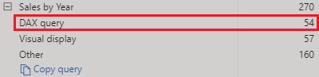
Analyze query plans for optimization opportunities
Count Customers =
CALCULATE (
DISTINCTCOUNT ( Order[ProductID] ),
FILTER ( Order, Order[OrderQty] >= 5 )
)
Count Customers =
CALCULATE (
DISTINCTCOUNT ( Order[ProductID] ),
KEEPFILTERS (Order[OrderQty] >= 5 )
)
Notes:
When you examine the results in the Performance analyzer pane, you can see how long it took the Power BI Desktop engine to evaluate each query (in milliseconds). A good starting point is any DAX query that is taking longer than 120 milliseconds. In this example, you identify one particular query that has a large duration time.
Performance analyzer highlights potential issues but does not tell you what needs to be done to improve them.
In this example, you are trying to count the total number of products with order quantities greater than or equal to five.
<CLICK>
Now the measure replaces the FILTER function with the KEEPFILTER function. When the test was run again in Performance analyzer, the duration was shorter as a result of the KEEPFILTER function.
https://learn.microsoft.com/dax/best-practices/dax-avoid-avoid-filter-as-filter-argument

Slide 55
Knowledge check: DAX optimization
What benefit do you get from analyzing the metadata?
The benefit of analyzing the metadata is that you can clearly identify data inconsistences with your semantic model.
The benefit of analyzing the metadata is to get familiar with your data.
The benefit of analyzing the metadata is to know the number of rows, columns and tables being loaded into your model.
Which of the following statements about relationships in Power BI Desktop is true?
Relationships can only be created between columns that contain the same data type.
Relationships can only be created between tables that contain the same number of rows.
Relationships can be created between tables that contain different types of data.
Notes:
Use the slide animation to reveal the correct answers.

Slide 56
Recap
In this section, we covered:
Definition of enterprise data and scalability.
Storage mode and model framework types.
Different relationships and ways they affect data filtering.
DAX variables and functions to improve readability and efficiency.

Slide 57
Further reading
Optimize a model for performance in Power BI
https://aka.ms/optimize-power-bi
Optimization guide for Power BI
https://learn.microsoft.com/power-bi/guidance/power-bi-optimization
Notes:
Encourage students to review the online material on Microsoft Learn on which this presentation is based.

Slide 58
Create and manage Power BI assets
Notes:
https://aka.ms/reusable-power-bi-assets
Before delivering this presentation, review the associated module on Microsoft Learn.
The estimated time to present these slides is 45 minutes.

Slide 59
Learning objectives
Create core and specialized semantic models.
Create Power BI Template and Power BI Project files.
Use lineage view and endorse data assets in Power BI service.
Use XMLA endpoint to connect semantic models.

Slide 60
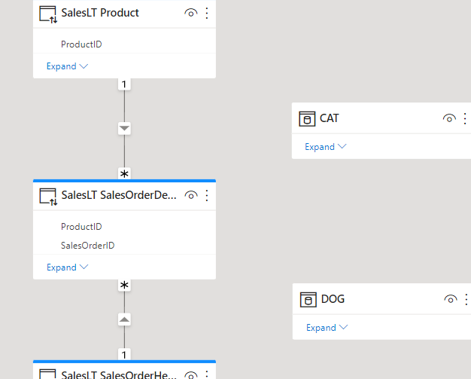
Create reusable Power BI assets
Specialized semantic model
Specialized semantic models.
Create a core semantic model.
Connect to the Power BI semantic model as a live connection.
Extend the new semantic model as needed, creating a specialized semantic model.
Power BI Template (PBIT) files.
Preserves theme and report design.
Keep or remove semantic model data.
Core
Notes:
When you were first introduced to Power BI, you probably learned how to get data from various sources such as SQL Server databases, Excel files, and even text files. Creating the same or similar semantic model for each report is tedious work. Further, if others also want to develop reports on that exact semantic model, what's your process for sharing?
In this screenshot, see the core semantic model with three tables connected by relationships and two disconnected tables that were added to the model.
Create reusable core assets
Assets can mean semantic models, dataflows, reports, and dashboards, and we most commonly mean semantic models in this module. In our previous example, you spent precious time curating the perfect semantic model, and now you can share and reuse it. Before creating visuals, publish the file to Power BI service and effectively create a core semantic model.
Next time someone needs to create a report on that semantic model, they can connect to a Power BI semantic model from Power BI Desktop. If you publish to a shared location, it allows peers to use the same semantic model. A single shared semantic model protects data integrity. This trustworthy semantic model also prevents orphaned semantic models when someone recreates a report without deleting the earlier copies. As an enterprise data analyst, it's your responsibility to be a good data steward to encourage the democratization of data rather than disparate copies of data with questionable quality.
Create specialized semantic models
In our introduction example, we recognized the need to reduce report size and provide targeted reports across regions. To meet these goals, we can create specialized semantic models. Consider creating a new semantic model with the specific regional data, instead of limiting regional users access to a single global report.
To create a specialized semantic model, open a new Power BI Desktop instance and connect to the core semantic model. You're now connected live to that semantic model, which doesn't allow any changes to the model, but you can filter and visualize data. Use the Make changes to the model option to switch from a live connection to DirectQuery.
Note: You need a data gateway configured to support the DirectQuery model if you want to make changes to the underlying semantic model.
Power BI Template files
Power BI Template .pbit files allow you to save a report to reuse or share for different purposes. These template files are highly customizable, depending on your needs. When you saved a template file, it has all of the same information as if you saved a traditional .pbix file.
You can create a standardized report design template. Consider your organization is getting started with Power BI and users are still learning how to interact with reports. As an example, you can create a template with a header for title, description, and location for applicable slicers. You can now save and close the template, and then open the template to start creating your new report. If you have a report that already has your desired format, you can also remove all data sources and save it so only the theme and visual configurations are stored.
You can also use a template as a starting point for future reports or as a gold copy to preserve the state before modifying the report. In this scenario, you can create the entire report, then save as a template as an extra copy of the file. While it's not recommended to use a template file for version control, it might be helpful when you're still developing a report or are collaborating on the report and want a backup. Since Power BI templates open as an unsaved file, any changes made wouldn't affect the template file unless you specifically save and overwrite the template file.

Slide 61
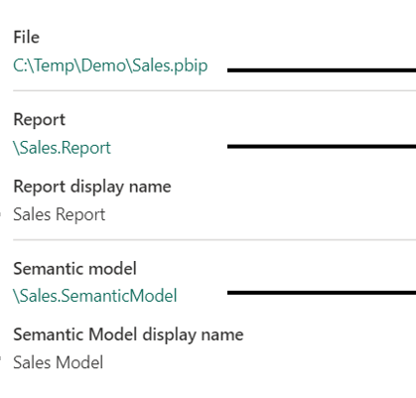
Develop with Power BI Projects
Code editor and source control friendly files.
Flat files can be edited using a code editor, like VS Code.
Easily see changes.
Notes:
Lifecycle management refers to the process of tracking and managing each stage of the development process. The Power BI report development process includes creating reusable assets and deciding how to handle changes to your semantic models and reports.
Traditional Power BI .pbix files store the semantic model and report in a single binary file, which doesn't allow granular tracking with source control. Power BI Project files, in combination with code editors and source control systems, allow you to track versions and manage code deployments as part of a Continuous Integration Continuous Delivery (CI/CD) system.
Create a Power BI Project file
Power BI Project files store your semantic model and report in individual plain text files for use with code editors and source control solutions. There are many benefits to using Power BI projects to track and manage your report development:
Text editor support: Item definition files are JSON formatted text files containing semantic model and report metadata.
Source control: Power BI semantic model and report item definitions can be stored in a source control system, like Git.
These files can be used in a code editor like Microsoft Visual Studio Code (VS Code) to support Git integration. When you save your work as a Power BI Project (.pbip), the report and semantic model item definitions are saved as individual plain text files in a simple, intuitive folder structure.
Power BI Project structure
When you create a Power BI Project, all of the metadata is stored in flat files. As shown in the screenshot, there are separate folders for the semantic model and the report. This separation might feel familiar if you've published reports to the Power BI service before.
The semantic model folder stores all of the data stored in a semantic model, including relationships, measures, and transformations.
The report folder stores all of the data for the visuals and report pages, including custom visuals and mobile layout.
Existing Projects use TMSL (Tabular Model Scripting Language), which stores the data in a single model.bim file. You can enable and upgrade your Project to use TMDL (Tabular Model Definition Language), which stores the metadata in individual files. Power BI Projects are in preview and you might have a different folder structure if you don't have all preview features enabled.
The Project Report definition folder is available with the Enhanced .pbir (Power BI Report) format.

Slide 62
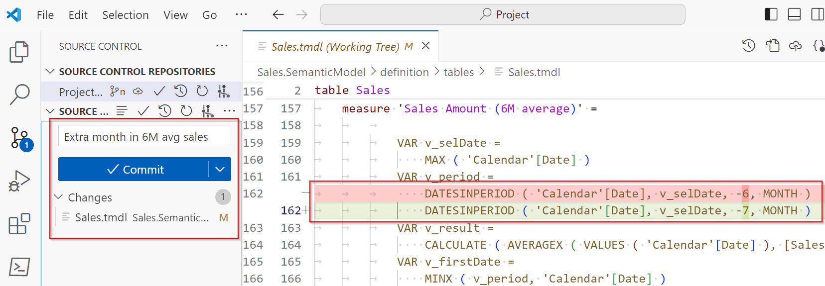
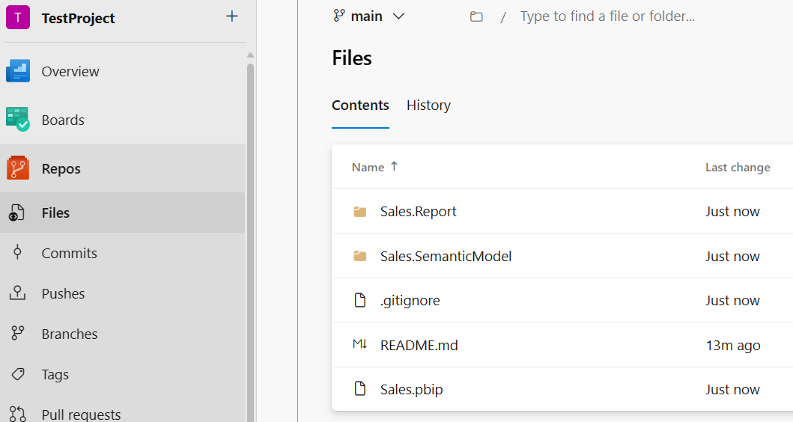
Track and manage changes
Notes:
Build slide. Click to fly in the Azure DevOps repo example.
Power BI .pbix files are binary and changes aren't visible in code editors. When changes are made to a file, you don't know if it's in the semantic model or visuals without reviewing the entire report and semantic model. When you use a Power BI .pbip file, you can continue to develop your report in Power BI Desktop and have a trackable record to review if a report isn't behaving as expected.
Let's expand on our example with a core semantic model and specialized semantic models for different regions. Consider your team stores Power BI files in OneDrive to have version control. You were informed that one of the custom regional reports isn't displaying accurate numbers and begin to investigate. You need to open either an older copy of the file or one of the other regional files and review them entirely to find the difference.
In comparison, if you have a Power BI Project and also use source control, such as Git, then you can review changes through previous pull requests to quickly see the change. Once you identify the change, you can compare it to the other file and make the necessary fix.
In the screenshot, you can see a difference in the measure where a single value 6 was changed to 7 by mistake. This example uses VS Code and Git to see the difference in the code and version history of previous changes.
CI/CD systems also typically use source control to track and manage changes. This version control with Power BI Project files is possible through Git integration. Git integration in VS Code enables developers working with Power BI Desktop projects to streamline development processes, source control, and collaboration with Git repositories. With Git integration, you can:
Backup and version your work.
Revert to previous states.
Collaborate with others or work alone using Git branches.
Use the capabilities of familiar source control tools, like Azure DevOps.
In the second screenshot, you can see the Azure DevOps repo (repository) with files in the main branch. Developers can clone this repo, create their own development branches, and then create pull requests to merge into main. This development process allows collaboration on the same content without losing work.

Slide 63
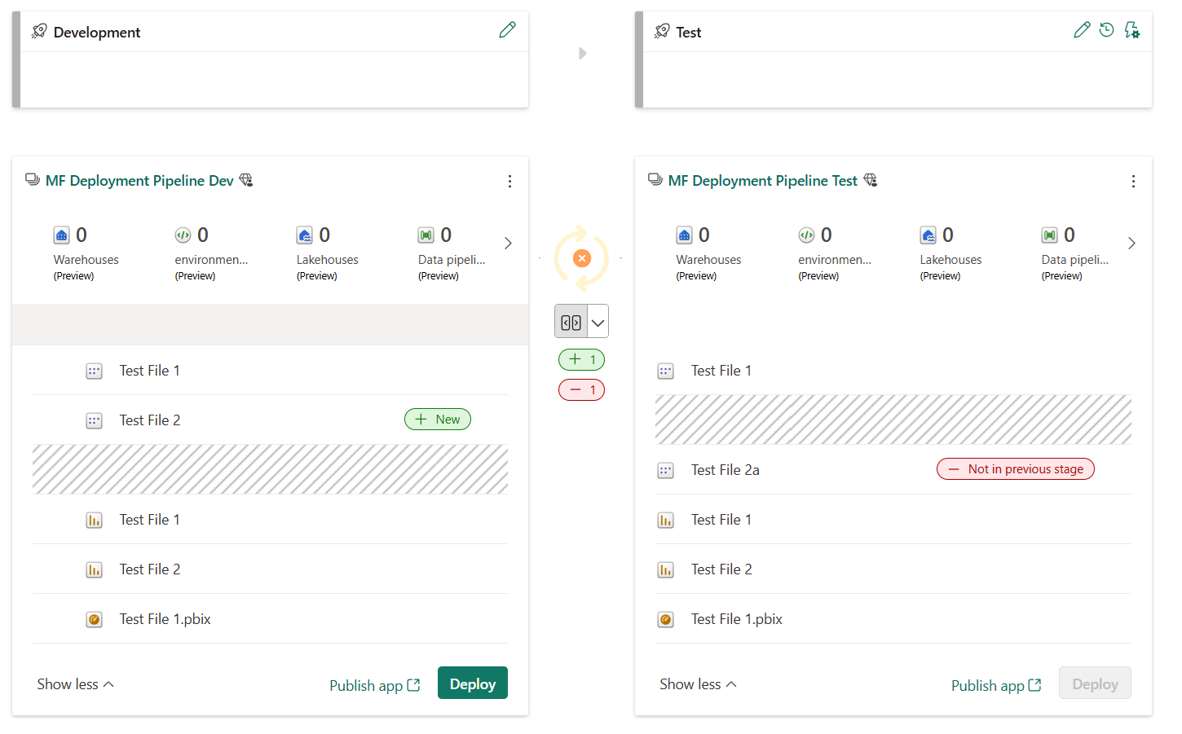
Use Deployment pipelines
Track changes across Fabric workspaces.
Supports most Fabric items.
Customizable pipeline configuration for workspaces.
Part of a CI/CD system.
Notes:
Continuous Integration and Continuous Delivery (CI/CD)
Many organizations use CI/CD systems to propose and validate changes during development before releasing them to production. A common system design has different stages to perform checks between Development and Test environments before deploying to Production.
In the Power BI service, you can use Deployment pipelines to create different workspaces that match your stages. Once you have your pipeline and workspaces configured, when you make changes in Development, you can see the difference between Test before deploying the changes. The screenshot shows how the changes between the stages are visually represented.

Slide 64
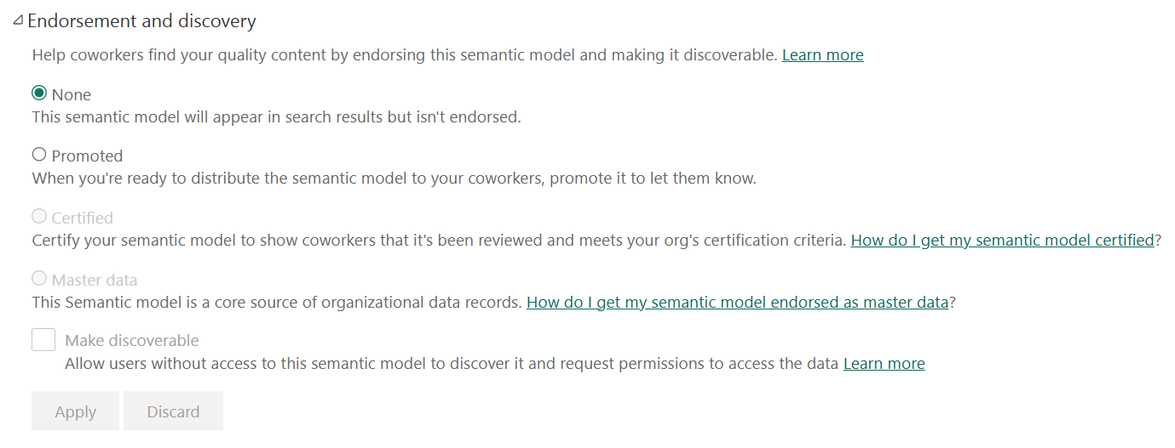
Endorse semantic models
Build and share trusted data.
Ensure consistency and accuracy.
Configurable settings to get data Certified or marked as Master data.
Notes:
Users can discover other semantic models in the Power BI service and build their own reports. You can use this feature and make it easier for collaboration through Endorsement. Endorsement helps users find high-quality content they need by identifying the contest as verified and trustworthy.
Items can receive one of three endorsement badges - Promoted, Certified, or Master data:
Promoted means that the item creators think the item is ready for sharing and reuse. Any user with write permissions on an item can promote it.
Certified means that an organization-authorized reviewer has certified that the item meets the organization's quality standards, can be regarded as reliable and authoritative, and is ready for use across the organization.
Master data means the data in the item is a core source of organizational data. The master data designation might be used to indicate a single source of truth for certain kinds of data, such as product codes or customer lists.
The screenshot shows the Endorsement and discovery section in the semantic model settings. For both Certified and Master data, there are links to help you know how to get your data certified or endorsed as master data. These links are configured by an administrator for your organization. Also note the option to make the item discoverable or not.
Note: all Fabric items, except Power BI dashboards can be endorsed.

Slide 65
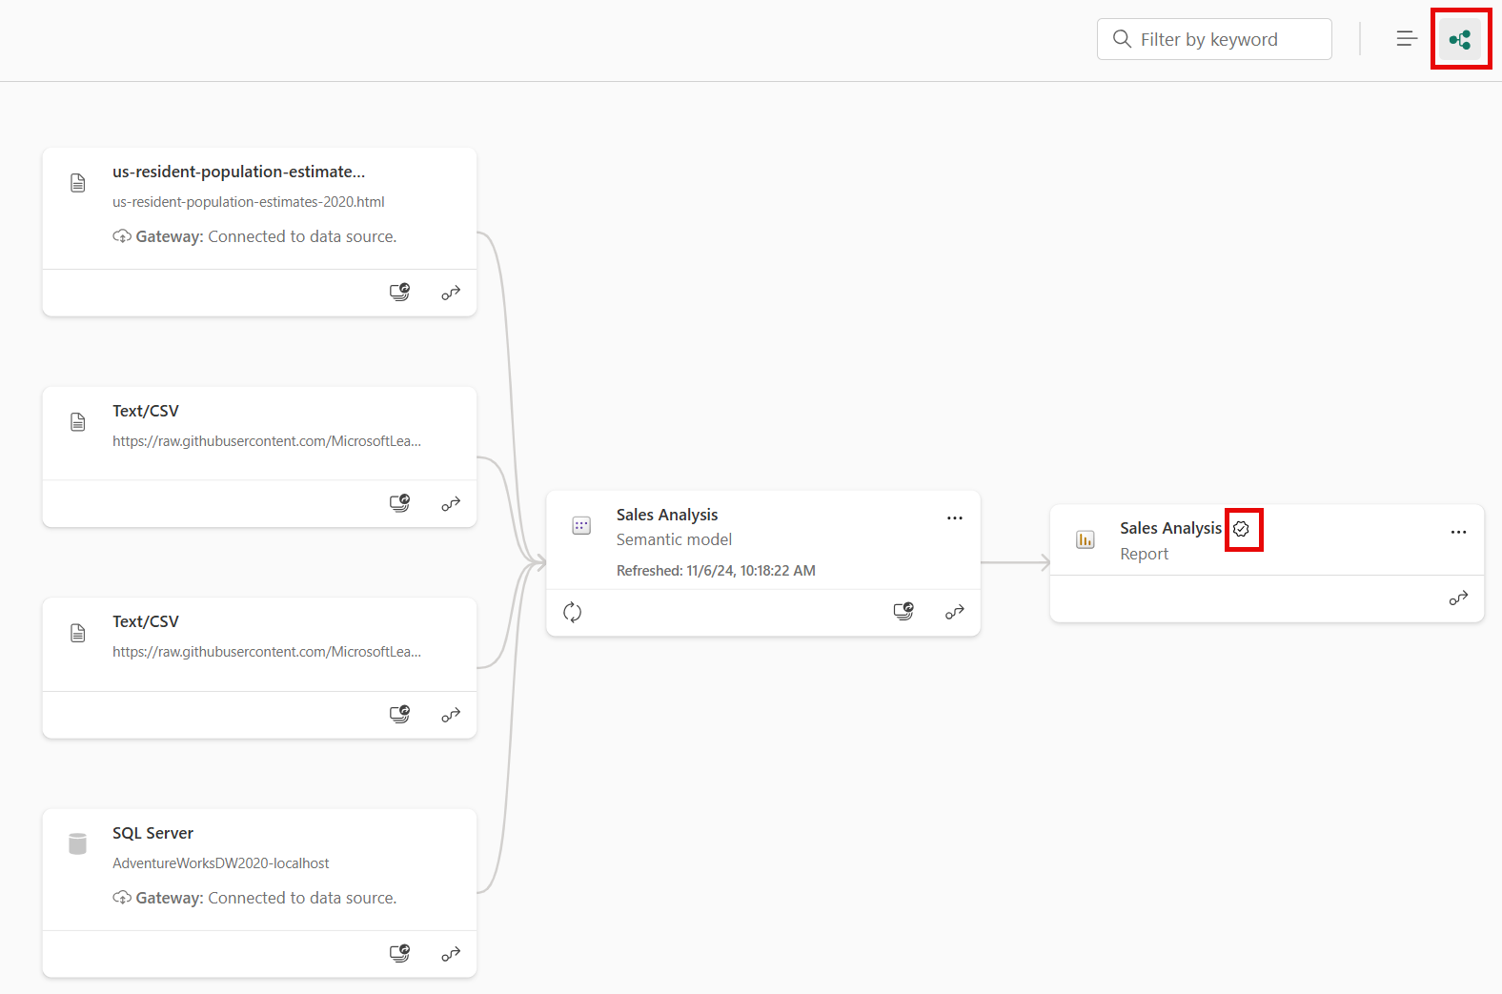
Explore with Lineage view
All data sources.
All dependencies across items.
Spans workspaces.
View impact analysis for upstream items.
Notes:
Lineage view in a Power BI workspace allows you to view dependencies between the different workspace items. An example would be seeing underlying data sources for a semantic model and the final report all connected by lines.
In the screenshot, we explore a single workspace in lineage view. From left to right, you see different data sources, the semantic model, and finally the report.
The data sources include an HTML file, two different Text/CSV files, and a SQL Server.
The Sales Analysis semantic model comprises all of the data sources.
The Sales Analysis report is built from the Sales Analysis semantic model.
Notice how the Sales Analysis report has a badge with a checkmark in it, which indicates that the report is Promoted.
Lineage view allows you to quickly identify dependencies across a workspace for your assets. This view gives you easy administration especially when you have many items in a single workspace. Further perform impact analysis on the upstream items including data sources and semantic models, as a form of data governance.

Slide 66
Manage a Power BI semantic model using XMLA endpoint
Some common uses of the XMLA endpoint in Power BI:
Refreshing individual components of a data model.
Systematically exporting data from the data model.
Automating the use of the Best Practice Analyzer.
Notes:
If you've used Microsoft Analysis Services, you might be familiar with XMLA endpoint. While using an API might feel intimidating to some, it's straightforward to use. In short, the XMLA endpoint is another way for you to connect to Power BI workspaces and semantic models from external applications - just an API with a URL to the workspace or semantic model.
XMLA endpoint settings
By default, endpoint connectivity is read-only for the semantic models workload. This setting allows data visualization tools access to the following semantic model details:
Model data
Metadata
Events
Schema
Some data visualization tools include Microsoft Excel, Power BI Report Builder, Tabular Editor, or ALM Toolkit. You can get the workspace connection URL in workspace settings.
Read-write connectivity can be enabled to provide more operations, including:
Management
Governance
Advanced semantic modeling
Debugging
Monitoring
With read-write enabled, semantic models have more parity with Azure Analysis Services and SQL Server Analysis Services enterprise grade tabular modeling tools and processes. In order to use XMLA endpoint for read-write operations, the semantic model must reside in a Premium or Fabric workspace.

Slide 67
Exercise
Create reusable Power BI assets
30 minutes
Notes:
https://aka.ms/mslearn-fabric-reusable-assets

Slide 68
Knowledge check
1
What feature must be enabled for you to manage Power BI semantic models from external tools?
Power BI Service API.
Read-write XMLA endpoint.
Read-only XMLA endpoint.
2
Which Power BI file type allows you to track and manage changes using VS Code and Git?
Power BI Project .pbip file.
Power BI Template .pbit file.
Power BI Data Source .pbids file.
3
A report developer in an organization is trying to connect to curated semantic models but is unsure which ones to use. They come across a model with a 'Promoted' badge. What does this imply?
The model has been reviewed and certified by an organization-authorized reviewer as meeting the organization's quality standards.
The creators of the model believe it's ready for sharing and reuse within the organization.
The data in the model is a core source of organizational data and is regarded as the authoritative, single source of truth for certain kinds of organizational or business data.
Notes:
Allow students a few minutes to think about the questions, and then use the animated slide to reveal the correct answers.

Slide 69
Recap
In this section, we covered:
Core and specialized semantic model design.
Power BI Templates.
Power BI Projects and combination with Git and Deployment pipelines to support lifecycle management.
Endorsement and Lineage view in the Fabric service.
XMLA endpoint uses.

Slide 70
Further reading
Create and manage Power BI assets
https://aka.ms/reusable-power-bi-assets
Notes:
Encourage students to review the online material on Microsoft Learn on which this presentation is based.

Slide 71
Enforce semantic model security
Notes:
aka.ms/fabric-model-security
Before delivering this presentation, review the associated module on Microsoft Learn.
The estimated time to present these slides is 30 minutes.

Slide 72
Learning objectives
Restrict access to Power BI model data with RLS.
Restrict access to Power BI model objects with OLS.
Apply good development practices to enforce Power BI model security.

Slide 73
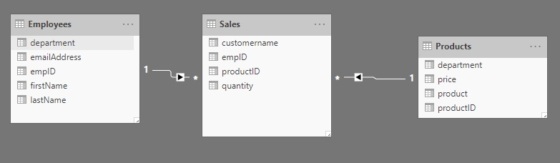
Security overview in Power BI
Notes:
In Power BI, you can secure reports and workspaces by sharing them to active directory users and groups. It is also possible to share a single report, but have users see different data, according to their job role.
<NOTE: use the image in this slide to explain the following:>
For example, You would like to make one report where employees in a specific department can only see the sales for that department. For instance, Maria Cameron works in the Game department and should only see the sales from that department. She should not see the sales from Sports, Clothing, or Automotive.
There are two ways to implement row-level security in Power BI: the static method and the dynamic method.
Row-level security (RLS) uses a DAX filter as the core logic mechanism. This module will demonstrate how you can implement row-level security in Power BI using DAX to ensure that only the appropriate person is seeing the appropriate records.

Slide 74
Restrict access to Power BI model data
Restrict access to Power BI model data by:
Apply star schema design principals
Define rules
Validate roles
Set up role mappings
Use single sign-on (SSO) for DirectQuery sources
Apply star schema design principals to produce a model comprising dimension and fact tables.
Static rules and dynamic rules
When you create roles, it’s important to test them to ensure they apply the correct filters.
Role mappings must be set up in advance of users accessing Power BI content.
When your data model has DirectQuery tables and their data source supports SSO, the data source can enforce data permissions.
Notes:
Apply star schema design principals
We recommend you apply star schema design principals to produce a model comprising dimension and fact tables. It’s common to set up Power BI to enforce rules that filter dimension tables, allowing model relationships to efficiently propagate those filters to fact tables.
Define rules
Rule expressions are evaluated within row context. Row context means the expression is evaluated for each row using the column values of that row. When the expression returns TRUE, the user can “see” the row. You can define rules that are either static or dynamic.
Static rules: The simplest static rule that you can create restricts access to all table rows. You can also restrict access to a particular region for example.
Dynamic rules: Dynamic rules use specific DAX functions that return environmental values (as opposed to constants). Environmental values are returned from three specific DAX functions:
USERNAME or USERPRINCIPALNAME – Returns the Power BI authenticated user as a text value.
CUSTOMDATA - Returns the CustomData property passed in the connection string. Non-Power BI reporting tools that connect to the semantic model by using a connection string can set this property, like Microsoft Excel.
Validate roles
When you create roles, it’s important to test them to ensure they apply the correct filters. For data models created in Power BI Desktop, there’s the View as function that allows you to see the report when different roles are enforced, and different username values are passed.
Set up role mappings
Role mappings must be set up in advance of users accessing Power BI content. Role mapping involves assigning Azure Active Directory (Azure AD) security objects to roles. Security objects can be user accounts or security groups.
For Power BI Desktop developed models, role mapping is typically done in the Power BI service. For Azure Analysis Services or SQL Server Analysis Services models, role mapping is typically done in SSMS.
Use SSO for DIrectQuery
When your data model has DirectQuery tables and their data source supports SSO, the data source can enforce data permissions. This way, the database enforces RLS, and Power BI semantic models and reports honor the data source security.

Slide 75
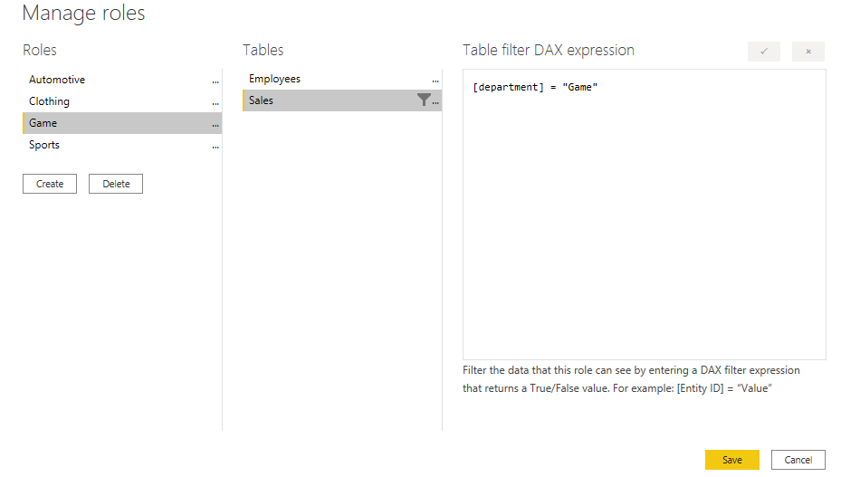
Configure roles with Static method
Notes:
The static method in Row-level security (RLS) uses a fixed value in the DAX filter, while the dynamic method uses a DAX function.
Power BI Row-level security (RLS) uses DAX to control who can see which data. Think of it as always adding another filter to the appropriate users, no matter what filters, slicers, or interactions they choose on a Power BI Report. Each time a member of that role interacts with the report, Power BI will add that filter to their interactions, thus limiting them what they see. Notice how you use a fixed value in the filter on the right-side of the equal sign, in this case, "Game". This means that if you ever need to add a category, you would need to create a new role with a new value in the DAX expression.
There are several steps to configure static RLS:
Create a report: First, we follow the typical steps to create a report in Power BI Desktop. Confirm that the relationship exists between the two tables using the modeling tab. It should be a 1 to many relationship on the empID column.
Create the RLS role using DAX: Power BI Row-level security (RLS) uses DAX to control who can see which data. Think of it as always adding another filter to the appropriate users, no matter what filters, slicers, or interactions they choose on a Power BI Report.
Test the role: Validate that this is working by selecting the Modeling tab, and select View as Roles.
Deploy the report: Deploy the report to the Power BI service by selected the Publish button on the Home tab. Choose a workspace.
Add members to the role: Navigate to your workspace in the Power BI Service. The Row-Level Security screen appears. From here, you can add active directory users and security groups to the security role. When members are added to this role, they will have the DAX filter that you previously defined applied to them.
Test the roles: You can also test this inside the Power BI Service. If you select the ellipsis next to the Game role on this screen, you can see Test as role.

Slide 76
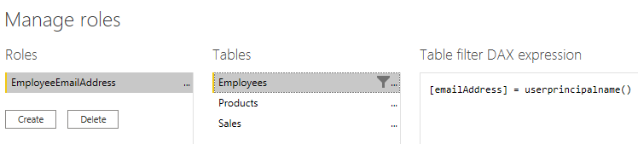
Use a dynamic value with DAX filters
Notes:
There's a way to set up row-level security only once, without the need to continue to maintain it dynamically.
Instead of the fixed string we used before like "Game" or "Clothing", we're using a DAX function in the row-level security filter. This function, userprincipalname(), will compare the email address from the Employees table with the email that the user uses to log into the Power BI service.
If he uses the email address russel@tailwindtraders.com to sign in to the Power BI service, it will compare that value to the email address in the Employees table. Assuming there's a relationship created between Employees and Sales, the user will only see the data he or she created.

Slide 77
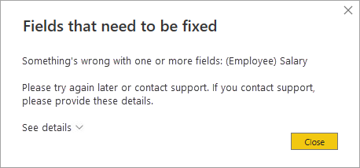
Restrict Access to Power BI model objects
Object-level security (OLS)
Set up OLS:
Create roles
Add OLS rules to the roles
Considerations:
When a user doesn’t have permission to access a table or column, they'll receive an error message.
Restrictions:
You can’t mix RLS and OLS in the same role.
Notes:
Object-level security (OLS) can restrict access to specific tables and columns, and their metadata. Typically, you apply OLS to secure objects that store sensitive data, like employee personal data.
When Power BI enforces OLS, not only does it restrict access to tables and columns, but it can also secure metadata. When you secure metadata, it’s not possible to retrieve information about secured tables and columns by using Dynamic Management Views (DMVs).
OLS is a feature inherited from Azure Analysis Services (AAS) and SQL Server Analysis Services (SSAS). The feature is available in Power BI Premium to provide backward compatibility for models migrated to Power BI. For this reason, it’s not possible to completely set up OLS in Power BI Desktop.
Set up OLS:
To set up OLS, you start by creating roles. You can create roles in Power BI Desktop in the same way you do when setting up RLS. Next, you need to add OLS rules to the roles. This capability isn’t supported by Power BI Desktop, so you’ll need to take a different approach.
You add OLS rules to a Power BI Desktop model by using an XML for Analysis (XMLA) endpoint. XMLA endpoints are available with Power BI Premium, and they provide access to the Analysis Services engine in the Power BI service.
Considerations:
Consider carefully whether OLS is the right solution for your project. When a user opens a Power BI report that queries a restricted object (for them), the error message could be confusing and will result in a negative experience. To them, it looks like the report is broken. A better approach might be to create a separate set of models or reports for the different report consumer requirements.
Restrictions:
You can’t mix RLS and OLS in the same role. If you need to apply RLS and OLS in the same model, create separate roles dedicated to each type.
Also, you can’t set table-level security if it breaks a relationship chain. For example, if there are relationships between tables A and B, and B and C, you can't secure table B. If table B is secured, a query on table A can't transit the relationships between table A and B, and B and C. In this case, you could set up a separate relationship between tables A and C.

Slide 78
Apply good modeling practices
Define fewer semantic models with well-designed roles.
Create fewer roles by using dynamic rules.
Create rules that filter dimension tables instead of fact tables.
Validate that the model design, including its relationships and relationship properties, are correctly set up.
Use the USERPRINCIPALNAME function instead of USERNAME function.
Rigorously validate RLS and OLS by testing all roles.
Ensure that the Power BI Desktop data source connection uses the same credentials that will be applied when set up in the Power BI service.
Notes:
It’s critical that your model enforces data permissions correctly and efficiently. The following list provides you with good development practices to apply.
Strive to define fewer semantic models (data models) with well-designed roles.
Strive to create fewer roles by using dynamic rules. A data-driven solution is easier to maintain because you don’t need to add new roles.
When possible, create rules that filter dimension tables instead of fact tables. It will help to deliver faster query performance.
Validate that the model design, including its relationships and relationship properties, are correctly set up.
Use the USERPRINCIPALNAME function instead of USERNAME function. It provides consistency when validating the roles in Power BI Desktop and the Power BI service.
Rigorously validate RLS and OLS by testing all roles.
Ensure that the Power BI Desktop data source connection uses the same credentials that will be applied when set up in the Power BI service.

Slide 79
Exercise
Enforce model security
45 minutes
Notes:
A virtual machine (VM) containing the client tools you need is provided, along with the exercise instructions.
In this lab, you will update a pre-developed data model to enforce security. Specifically, salespeople at the Adventure Works company should only be able to see sales data related to their assigned sales region.
In this lab, you learn how to:
Create static roles.
Create dynamic roles.
Validate roles.
Map security principals to semantic model roles.

Slide 80
Knowledge check (1/2)
1
Joshua is a data modeler at Adventure Works who is developing a model for a large data warehouse. The model must enforce RLS, and the Power BI reports that connect to the model should deliver the fastest possible performance. What should Joshua do?
Apply rules to dimension tables.
Apply rules to hierarchies.
Apply rules to fact tables.
2
Rupali is a data modeler at Adventure Works who is developing an import model to analyze employee timesheet data. The employee table stores the employee social security number (SSN) in a column. While the model will be available for all company managers, it will also be available to employees in the Payroll department. However, reports must only reveal employee SSNs to payroll employees. What feature should Rupali use to restrict access to the SSN column?
RLS
SSO
OLS
Notes:
Allow students a few minutes to think about the questions, and then use the animated slide to reveal the correct answers.
This is a build slide. Each question will appear with answers. Click one will add a check mark to the answer. Click two will expose the next set of questions and answers.
These questions are intended to generate discussion.

Slide 81
Knowledge check (2/2)
3
Kasper is a data modeler at Adventure Works who is developing a model that must enforce RLS. It must restrict access to only the sales regions assigned to the report consumer. The source database includes a table that stores employee usernames and their assigned region(s). What should Kasper do?
Create an OLS role and use a dynamic rule.
Create an RLS role and use a dynamic rule.
Create an RLS role and use a static rule.
Notes:
This is a build slide. Each question will appear with answers. Click one will add a check mark to the answer. Click two will expose the next set of questions and answers.
These questions are intended to generate discussion.

Slide 82
Recap
In this section, we covered:
Restricted access to Power BI model data with RLS.
Restricted access to Power BI model objects with OLS.
Reviewed development practices to enforce Power BI model security.

Slide 83
Further reading
Enforce semantic model security
https://aka.ms/fabric-model-security
Power BI implementation planning: Security
https://learn.microsoft.com/power-bi/guidance/powerbi-implementation-planning-security-overview
Notes:
Encourage students to review the online material on Microsoft Learn on which this presentation is based.

